Slide 1
XRN5236 - Reporting valid confirmed Theft of Gas into Central Systems (Mod0734)
ChMC September 2022

Slide 2
Background
UNC Modification 0734 was approved by UNC Panel in February and is currently awaiting implementation. The intent of this Modification is to introduce a new process to help ensure that valid confirmed theft data (claims), received from Suppliers via the Retail Energy Code Company (RECCo), are appropriately reported into central systems.
The workflow process for the Supplier theft reported contacts (SUT) is being built into the new CMS replacement and has been absorbed into the subscription costs, resulting in no additional funding required by customers for the technical part of the solution. It is also one of the first processes to be delivered through the new solution in order to implement the Modification as soon as practically possible.
Based on the expected complexity and increased volumes of SUT contacts, we believe additional resource is required to support the new theft process. The following slides provide detail and options for a way forward for the next 6 months following implementation of Mod0734.
Modification 0734 significantly changes the current Shipper theft process.
The new process is more complex and assumes drastically higher volumes of theft cases requiring processing.
Based on RECCo (and previously SPAA) data, expected volumes are around 1000 theft contacts per month compared to the current 260 theft contacts per month.

Slide 3
What is required from ChMC
Discuss the different options for managing the new Supplier Theft (SUT) process to be introduced via Modification 0734.
Provide approval on the chosen option following which a BER will be created for formal approval.
CDSP to seek formal approval of the BER (for the chosen option) in October’s ChMC meeting.

Slide 4
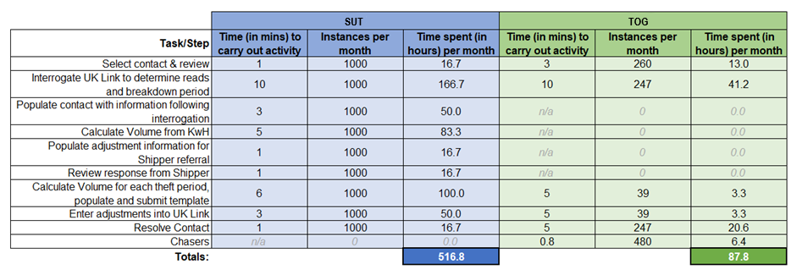
Low Level Task Comparison
The below table shows each task carried out in the resolution of theft contacts and how the numbers compare between current and new process

Slide 5
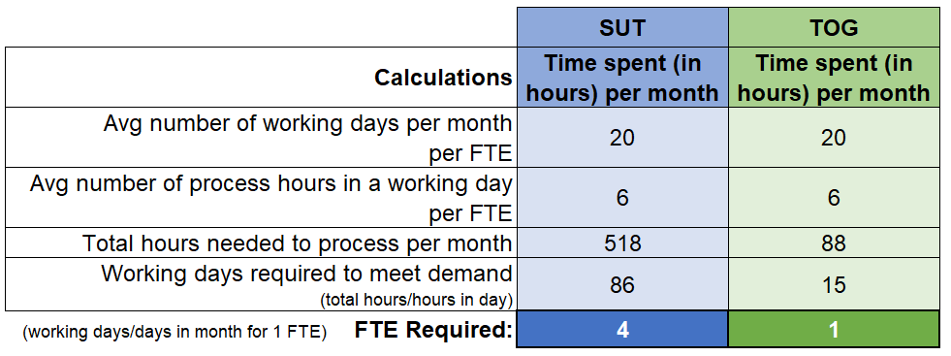
Full Time Equivalent (FTE) Comparison
The table shows the calculation and FTE requirements for managing theft contacts, and the comparison between the current and new process.
As highlighted above, the current theft process (TOG) has 1 FTE, however the new theft process, introduced under Modification 0734 (SUT), based on the indicative figures, will require 4 FTE.

Slide 6
Option 1 - Use Current Resource
Additional Information
Option 1
Use Current Resource
It would be accepted that a large backlog of contacts would be expected to build up and be ongoing if assumptions on volumes are correct (1000 contacts per month).
Existing resource utilised with no incremental resource.
No immediate impact to DSC change budget.
Potential backlog of SUT contacts delaying theft charges to relevant suppliers and opposite credits to UIG would be expected.
We would expect BP23 would need to include assumed resources following review period (6 months).
No Performance Indicators for 6 months, review findings to be taken to ChMC in April 23.
BP22 DSC Change Budget
£0
Utilise the current 1 x FTE working on TOG contacts, to be transferred to SUT contacts moving forwards. No increase in resources.
BP23 Ongoing Uplift
£0
Funding Party
N/A

Slide 7
Option 2 - Increase Resource by 2 FTE
Additional Information
Option 2
Increment by 2 FTE
This would result in £37k of Change Budget (6 months x 2 FTE) required and ongoing costs of £74k with backlogs growing and enduring if assumptions are correct
2 additional FTE and 1 existing FTE
Still expected to result in ongoing and increasing backlog of SUT contacts, delaying theft charges to relevant suppliers and opposite credits to UIG.
Reduced backlog build up when compared to Option 1, meaning charges invoiced to relevant parties will happen more quickly.
No Performance Indicators for 6 months, review findings to be taken to ChMC in April 23.
BP22 DSC Change Budget
£37,000
Recruit 2 x FTE to work with the existing resource who would transfer from TOG contacts to SUT contacts moving forwards.
BP23 Ongoing Uplift
£74,000
Funding Party
100% Shipper - Service Area 1

Slide 8
Option 3 - Increment by 3 FTE
Additional Information
Option 3
Increment by 3 FTE
Contacts will be cleared with adjustments being processed to the relevant parties in a timely manner, expected no backlogs if assumptions are correct.
3 additional FTE’s.
6 months funding from ChMC (DSC Change Budget).
Enduring funding from BP23 onwards.
Resources recruited at point of implementation.
No backlogs expected to build up.
Timely invoicing to relevant parties.
Review findings to be taken to ChMC in April 23.
BP22 DSC Change Budget
£56,000
Based on analysis undertaken, recruit 3 FTE to manage expected number of SUT contacts per month.
BP23 Ongoing Uplift
£111,000
Funding Party
100% Shipper - Service Area 1

Slide 9
Options Summary
Option 1
Use Current Resource
Option 2
Increment by 2 FTE
Option 3
Increment by 3 FTE
No increase in FTE resources
--------------
No charge to DSC Change (BP22) and no increase in BP23
--------------
Potential risk of high SUT backlog and delay to invoicing.
Increase in FTE resources by 2
--------------
£34k charge to DSC Change (BP22) and £74k increase moving forwards (BP23)
--------------
Potential risk of SUT backlog and delay to invoicing.
Increase in FTE resources by 3
--------------
£56k charge to DSC Change (BP22) and £111k increase moving forwards (BP23)
--------------
Expected no SUT backlog, timely invoice.

Slide 10
Recommendation
Option 1
Use Current Resource
Option 2
Increment by 2 FTE
Option 3
Increment by 3 FTE
No increase in FTE resources
--------------
No charge to DSC Change (BP22) and no increase in BP23
--------------
Potential risk of high SUT backlog and delay to invoicing.
Increase in FTE resources by 2
--------------
£34k charge to DSC Change (BP22) and £74k increase moving forwards (BP23)
--------------
Potential risk of SUT backlog and delay to invoicing.
Increase in FTE resources by 3
--------------
£56k charge to DSC Change (BP22) and £111k increase moving forwards (BP23)
--------------
Expected no SUT backlog, timely invoice.

