Slide 1
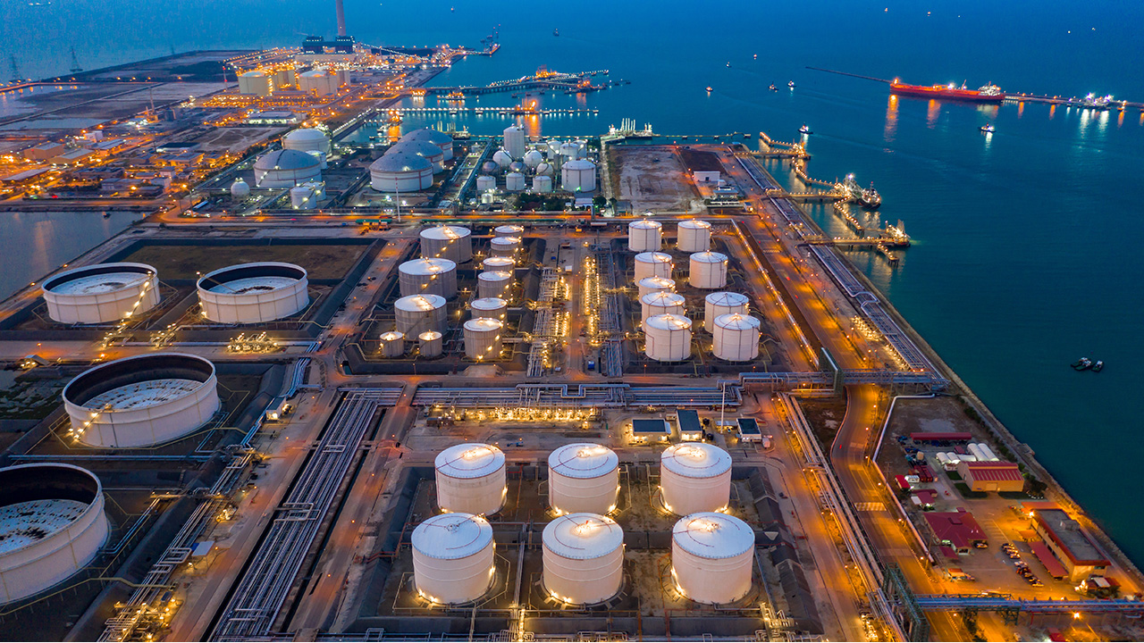
Update on ‘Line in the sand’ 2022/23 Strategy
Following dramatic rise in PAC risk 14 ‘No meter read line in the sand’, mitigations were proposed to tackle this risk across the year. This acts as a prompt for next steps and an update.

Slide 2

Background
Line in Sand risk presented at the Dec 2021 and Jan 2022 PAC following dramatic rise in Value at risk.
  Risk rating – 5 (highest risk banding)
  Indicative VaR – 464 GWh
Following risk review, PAC agreed to a strategy to tackle LiS and sent letter out to all parties as mitigation to the risk.
AUGE indicate this was the second highest contributor to UIG.
1https://www.gasgovernance.co.uk/sites/default/files/ggf/2022-03/AUG%20Presentation%2008042022%20v1.1.pdf

Slide 3

proposal
PAC agreed the approach outlined:
PAC reinforced importance of gaining reads for these sites in initial letter.
Use of targeted Comms for those with the highest proportion of No reads.
If by December 2022 no significant improvement evident in data, Shipper will be called in to PAC meeting to explain position and actions carried out to tackle no reads. Shippers to be informed in advance of this outcome for transparency.
Method of monitoring by PAFA - No read report on DDP.
Proposed timetable for events as detailed.

Slide 4
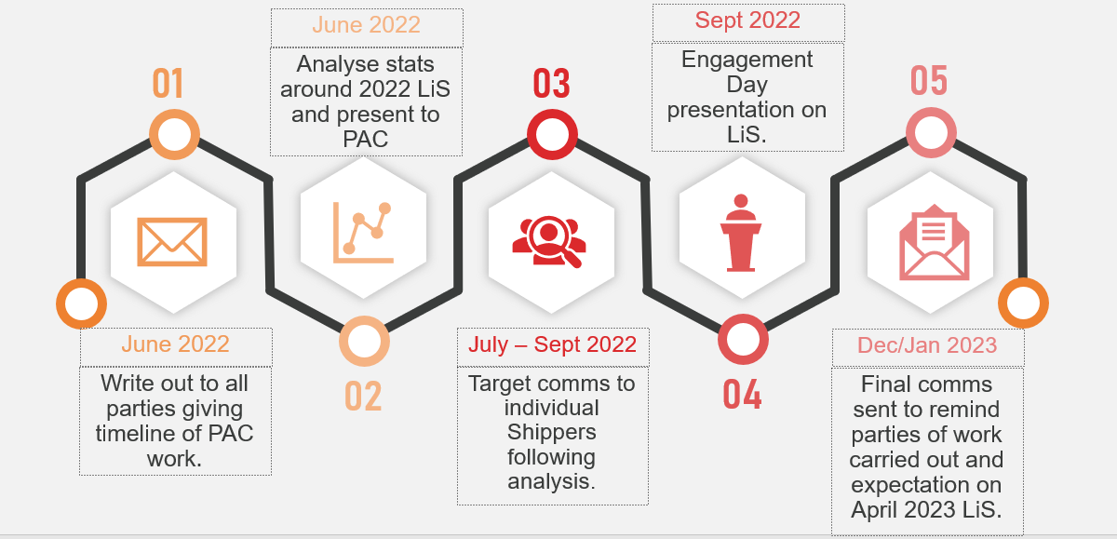
Tackling ‘Line in the sand’

Slide 5
Targeted Communications – Shipper basis
Two approaches could be taken by PAC on Line in the Sand;
Approach Shippers based on proportion of meters that were due to roll over in 2022, see breakdown of ‘Top 10’ Shippers to approach
Approach Shippers based on largest AQ at risk expected to roll. This is not the same as proportion and may see a leaning towards a particular sector due to AQ size.
Both have their merits to mitigating the risk level of PAC risk 14.
PAFA recommendation:
Option B) AQ at risk expected to roll. This is due to impact this would have on UIG levels by addressing some of these larger sites with high AQs thereby bringing down the risk level.

Slide 6
Option A) Shipper proportion of Line in Sand
SSC | # of Meters
Brazzaville | 176335
Islamabad | 139820
Wellington | 80882
Paramaribo | 75498
Nuuk | 43265
Dili | 35839
Yerevan | 35044
Sukhumi | 34345
Banjul | 22282
Bucharest | 16708
Rome | 11769
These are the 11 Shippers proposed to approach for individual targeting based on their proportion of Line in the Sand for 2022.
These 11 Shippers form 92% of the overall meters in question.

Slide 7
Option B) AQ at risk
SSC | Total AQ Roll (KwH)
Brazzaville | 2,068,101,158
Rome | 1,472,151,707
Islamabad | 1,292,089,014
Taipei | 1,292,089,014
Wellington | 1,201,346,803
Paramaribo | 918,369,004
Sukhumi | 482,828,346
Yerevan | 442,205,028
Nuuk | 394,322,600
Dili | 385,212,716
Gitega | 347,691,139
These are the 11 Shippers proposed to approach for individual targeting based on their proportion of Line in the Sand for 2022.
These 11 Shippers account for over 10,000,000,000 kWh of the 12,000,000,000 kWh AQ at risk.

Slide 8
Next steps
Next actions to be taken by PAFA;
Send out Draft individual targeted letter template to PAC for comment and approval.
PAC are asked to;
Approve list of Shippers to enter targeted comms based on either
  A) proportion of meters rolling over or
  B) AQ at risk. (Targeted comms to be carried out throughout September/October).
PAFA follow up actions;
Report back to PAC in November with recommendations on who to invite to December meeting.

