Slide 1
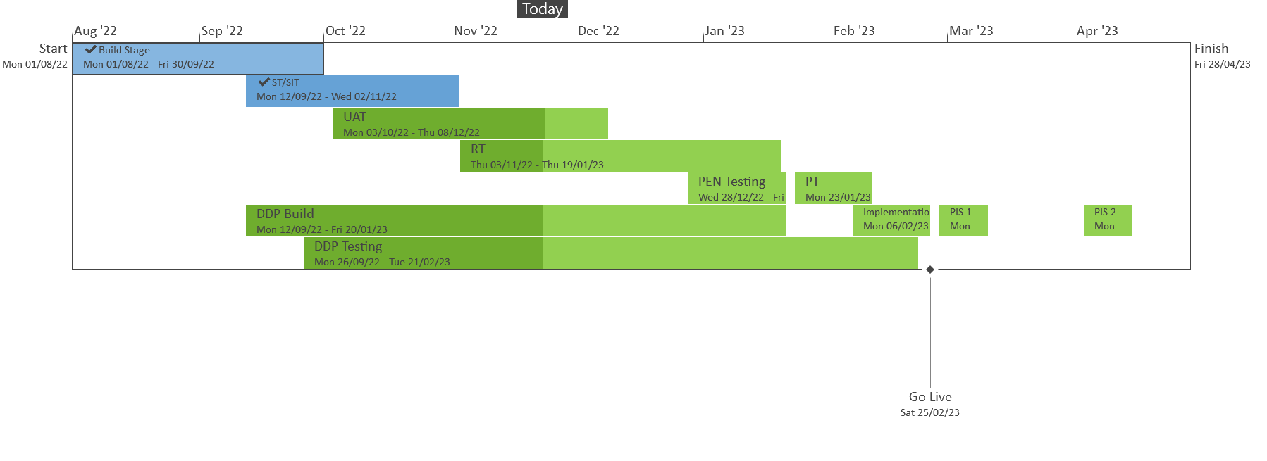
XRN5533 – February 23 Major Release - Status Update
 | Overall Project RAG Status
 | Schedule | Risks and Issues |  | Cost
RAG Status
Status Justification
Schedule | Overall release is tracking on target; Green, UK Link system testing phase completed on 28/10 as per plan. Currently on track to complete user acceptance testing phase 08/12, with regression testing prep in progress and test execution commencing on 12/12 Progress update: UK Link system testing completed on 28/10 DDP build for XRN4990 in progress, delivery on track to complete by 20/01 User acceptance testing on track to complete 08/12 Regression testing preparation in progress, test case execution to commence on 12/12 Decision in December ChMC: XRN5298 Detailed design change pack approval
Risks and Issues | XRN5298: There is a risk that UNC Modification 0799 will not be approved, leading to delays in build activities or a need to rework the proposed solution being delivered under XRN5298 in its entirety. While ChMC approved the move to deliver this change at risk under the assumption that the MOD will be approved, any potential regret spend associated with this change should this not be the case increases as build activities continue to progress. Update – UNC799 was approved on 18/11/22. Detailed design change pack to be presented for approval in December ChMC
Cost | Forecast to complete delivery against approved BER
Scope | XRN4900 - Biomethane/Propane Reduction XRN4978 - Shipper - Notification of Rolling AQ Value XRN4989B - Residual AMT activities XRN4990 - MOD0664 – Transfer of Sites with Low Read Submission Performance from Class 2 and 3 into Class 4 XRN4992B - MOD0687 - Clarification of Supplier of Last Resort (SoLR) Cost Recovery Process - Inner for replacement reads and read insertions​ XRN5298 - H100 Fife Project – Hydrogen Network Trial
Complete
On Track
At Risk
Overdue
Slide updated on 24th November 2022

