Slide 1
Milford Haven 18th January – Worked Example
Martin Cahill
02 March 2023 – Transmission Workgroup
National Gas Transmission |
Private & Confidential

Slide 2
Background
High flows at Milford haven due to backlog of cargos
Compressor trip late on the 17th, and knock on impact to other assets reduced ability to maximise transmission away from Milford
Constraint forecast if no changes to supply/demand
Milford Haven
Felindre Compressor
Wormington Compressor
Churchover Compressor
Compressor Train

Slide 3
Key Considerations
What is the magnitude of constraint?
What is the national balance position?
What offers are available?
Impact on current gas day and tomorrow
Manage Incentive Performance
Notes:
Level of Constraint
This will factor heavily into the decisions that GNCC make. In this example a reduction of just a few mcm of gas at Milford was assessed to be enough for flows to be within asset capability. The constraint could be much larger in a lot of scenarios – particularly if local demand was lower (for example over the summer months, or if pembroke power station was off). A larger constraint may have meant there was a need to take out other commercial actions such as capacity buybacks – which would have the potential to significantly increase the constraint management cost to Industry.
-locational actions work well but for small amounts
National Balance
Will cover in a bit more detail on next slide, however the national balance needs to be considered in conjunction with the constraint. GNCC will take action to reduce flows at Milford within capability, which will then impact on the national balance. However the national linepack is rarely balanced to begin with (or even starting the day where we would hope to finish it), so the Prevailing position will impact on whether we need to address the balance or not.
- Quite often don’t need to carry out secondary actions as system already heavy
What offers are available
GNCC rely on offers from Industry, both for locational actions and title trades. Sometimes there may be less liquidity or value- physical need may take precedence here, or on other occasins lack of value may prevent certain actions from being taken.
- Lead time may mean preference for more expensive bid
Current gas day and tomorrow
Is constraint expected the next day or is issue likely to reduce? Will impact on magnitude of action required. In general it is preferable where possible to resolve same day so that costs are targeted in the best way – for example on balance to shippers who are adding to imbalance on that gas day. However where cost can be kept down by easing imbalance across multiple days, then this may be preferable.
Manage incentive performance

Slide 4
National Balance
Opening linepack on the 18th January was 369.4mcm
This was the 7th highest opening linepack that we have had over the last year
Flexibility to lose some stock
However also need to manage risk of forecast colder weather

Slide 5
PCLP 18th January
OLP of 369.4mcm (dotted line)
PCLP (Green line) showing as significantly short early on in day

Slide 6
PCLP 18th January
OLP of 369.4mcm (dotted line)
PCLP (Green line) showing as significantly short early on in day
Sell Actions taken at 3 and 4pm
Balance already short, sell actions expected to impact this further
Sell 2.2mcm
Sell 1.9mcm

Slide 7
PCLP 18th January
OLP of 369.4mcm (dotted line)
PCLP (Green line) showing as significantly short early on in day
Sell Actions taken at 3 and 4pm
Balance already short, sell actions expected to impact this further
Secondary Buy Actions taken to improve national balance
Buy 1.2 mcm
Buy 0.5 mcm
Sell 2.2mcm
Sell 1.9mcm

Slide 8
PCLP 18th January
OLP of 369.4mcm (dotted line)
PCLP (Green line) showing as significantly short early on in day
Sell Actions taken at 3 and 4pm
Balance already short, sell actions expected to impact this further
Secondary Buy Actions taken to improve national balance
PCLP increased more than expected, mitigating the need for any further actions
Buy 1.2 mcm
Buy 0.5 mcm
Sell 2.2mcm
Sell 1.9mcm

Slide 9
PCLP 18th January
OLP of 369.4mcm (dotted line)
PCLP (Green line) showing as significantly short early on in day
Sell Actions taken at 3 and 4pm
Balance already short, sell actions expected to impact this further
Secondary Buy Actions taken to improve national balance
PCLP increased more than expected, mitigating the need for any further actions
Buy 1.2 mcm
Buy 0.5 mcm
Sell 2.2mcm
Sell 1.9mcm

Slide 10
Locational/Physical Balance Considerations
When a shipper has a locational offer accepted, they must adjust their nomination to reflect this
However, there is nothing to prevent another shipper from increasing their nomination at the same location – something which could be encourage by a purchase of title gas
On 18th January there was some scope (though limited) for other shippers to increase their nomination without over-running on existing capacity holdings
Notes:
PRI – if don’t adjust nomination get additional charges
Encouraged by title gas remove? Subject to capacity
(obligation)

Slide 11
Price Spread - Locational Actions vs SMP Buy/Sell
Both locational sells and buys taken on the day were significantly below/above market prices on the day
These were still the best available offers, and taken to ensure safe physical operation:
Increase in stock
Minimising risk of increase to supply (or demand reduction) in Milford region
Price p/kwh

Slide 12
NGT Buy Actions vs SAP - Difference
Average = max buy is roughly 10% above the SAP price for the day
Maximum difference seen over the last year is an additional 50% above the SAP price
Max Locational buy on the 18th was around 60% above SAP, so a high level in comparison, though would expect less value in the market
Price p/kwh

Slide 13
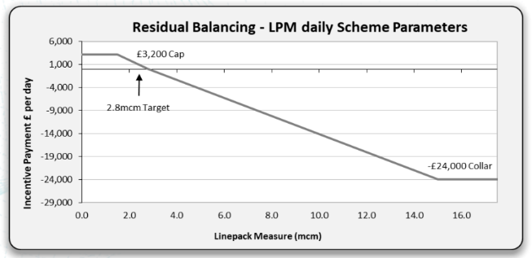
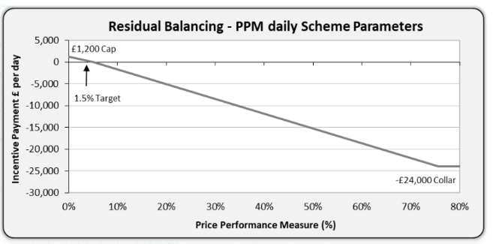
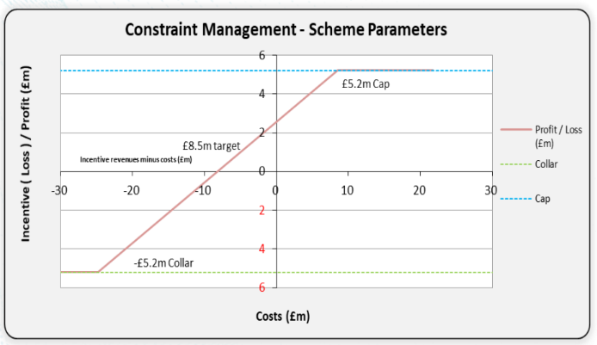
How are we incentivised?
Linepack Measure
Incentivised to change daily linepack (Opening Linepack – Closing Linepack) by less than 2.8mcm
Maximum Daily Revenue is £3,200 by keeping change below 1.5mcm
Maximum Daily Loss is £24,000 for a change 15mcm or above
Price Performance Measure
Target of 1.5% trading range from SAP
Max £1200 revenue from 0 differential
Max loss £24,000 range 76% or above
Only applies to NBP Title Trades
Constraint Management
Includes Locational Actions & other constraint tools
Target of £8.5m annual constraint costs
Sharing Factor of 39% NGT, 61% Shippers

Slide 14
Cost Calculation and Examples
On the 18th:
Location Sell Action Revenue: £1.44m (4.11 mcm)
Locational Buy Action Expense: £1.44m (1.79 mcm)
~ negligible cost for industry
If we had bought the same amount of location gas as sold for balance, then cost would have been:
Location Sell Action Revenue: £1.44m (4.11 mcm)
Locational Buy Expense: £3.31m
Balancing Neutrality cost: £1.87m
50% Sell, 25% Buy, 50% Buyback:
Location Sell Action Revenue: £0.72m (2.05 mcm)
Locational Buy Expense: £0.82m (1.03 mcm)
Buyback Expense: £1.79m (2.05 mcm)
Balancing Neutrality cost: £1.89m
Larger imbalance, 50/25/50 (22mcm)
Location Sell Action Revenue: £3.85m (11mcm)
Locational Buy Action Expense: £4.42m (5.5mcm)
Buyback Expense: £9.62m (11mcm, 150% SAP)
Balancing Neutrality cost = £10.19m
Net Revenue/Cost from Locational Actions and Buybacks goes into Capacity Neutrality
Sharing Factor: 39% National Gas, 61% Shippers
Costs split based on Shippers Firm Entry Capacity holdings on day (as a proportion of all users)

Slide 15
Thank you

