Slide 1
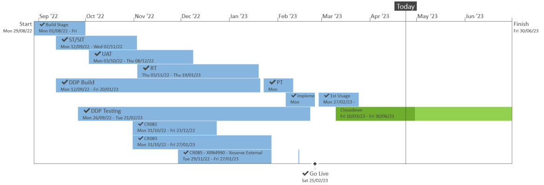
XRN5533 – February 23 Major Release - Status Update
 | Overall Project RAG Status
 | Schedule | Risks and Issues |  | Cost
RAG Status
Status Justification
Schedule | Overall release is tracking on target; Green, all XRNs have been successfully implemented on 25/02 and Post Implementation Support (PIS) completed on 24/03. Closedown in progress, on track for 30/06. Progress update: First usage for XRN4992B and XRN4990 will be completed in May 23 and July 23 respectively by June 23 Project Team Project closedown in progress, on track to complete by 30/06 Change Completion Report (CCR) to be issued for approval at June’s ChMC Decision in May ChMC: None |  | Successful Implementation of 25th February 23
Risks and Issues | There is a risk that the solutions being delivered under XRN4900 and XRN5298 may not work as expected at the point SGN go live with the Biomethane and H100 projects, due to the gap between these changes being delivered within the Feb 23 release and the respective go live dates of the projects. Update - SGN have confirmed that the first H100 connection will be sometime between June-Sept 2024. CDSP are awaiting further clarification regarding the go live date of the Biomethane project. Discussions are underway regarding options for carrying out additional testing closer to the project go live dates, which may incur additional charges that weren't originally accounted for.
Cost | Forecast to complete delivery against approved BER
Scope | XRN4900 - Biomethane/Propane Reduction XRN4978 - Shipper - Notification of Rolling AQ Value XRN4989B - Residual AMT activities XRN4990 - MOD0664 – Transfer of Sites with Low Read Submission Performance from Class 2 and 3 into Class 4 XRN4992B - MOD0797 - Last Resort Supply Payments Volumetric Charges XRN5298 - H100 Fife Project – Hydrogen Network Trial
Complete
On Track
At Risk
Overdue
Slide updated on 24th April 2023

