Slide 1
National Gas Transmission Change Horizon
In-flight and Potential Programmes & Projects 2023-24 |  |  |  | 2023/2024
 |  |  |  | Jul 2023 | Aug 2023 | Sep 2023 | Oct 2023 | Nov 2023 | Dec 2023 | Jan 2024 | Feb 2024 | Mar 2024 | Apr 2024 | May 2024 | Jun 2024
In Flight Programmes 2023-2024 | Gemini Change programme Sustain Plus |  | Upgrading Gemini User experience and interfaces
 | Regulatory Change |  | Use of Entry Capacity Holdings at Easington at the Rough Storage ASEP in Winter 2023/2024 Mod 0846
Potential Programmes 2023-2024 | Potential Regulatory Change |  | Amendment to the Allocation of Entry Capacity and Flow Quantities to Qualifying CNCCD Routes Mod 823
2 Year Programme of work – Go-Live September 2024
Market Trials / Onboarding Period
First Focus Group
Second Focus Group
Ofgem Decision
Monthly Implementations
Ofgem Decision
NG / Xo Governance
Analysis to Implementation
Key Points
Mod846: Datafix approach will require six separate mini-drops throughout the winter of 23/34

Slide 2
Gemini Sustain Plus – Gemini Change Freeze Approach
Transmission Workgroup
5th October 23
National Gas Transmission |

Slide 3
What is meant by “Change Freeze”
Gemini Change Freeze does NOT mean a UNC Modification Freeze. UNC Modification process will continue to function as today.
The proposed Gemini Change freeze is ring-fenced to putting new change into the legacy Gemini platform.
Change development activities can continue during this time in updated Gemini platform for release in Q3/Q4 2024.
The freeze aims mitigate the need for any regret spend (e.g. spend into the legacy platform as well as the updated platform), alongside de-risking adding new change into the target system prior to implementation.
BAU processes to be followed for Regulatory change.

Slide 4
Gemini Change Freeze 2024
Q1
Q2
Q3
Q4
Q1
2024
Q2
Q3
Q4
1. Partial Freeze
2. Full Freeze
Cutover
Dress Rehearsal
Development
Testing
External Focus Groups
User Interface Go-Live
External Demos
Market Trials & Onboarding
Training Solution Development
Training Solution Delivery
Proposed ‘Change Freeze’ relates to changes going into the legacy Gemini platform. Change development activities can continue during this time in updated Gemini platform for release in Q3/Q4 2024.
Partial Freeze from March – April 2024
Full Change Freeze from May – September 2024
For information: there were no Regulatory Gemini changes in the equivalent period in 2023

Slide 5
Mitigations to “Change Freeze”
Continue to utilise existing processes to assess and share impacts of UNC change. Rough Order of Magnitude (ROM) process will continue to throughout the Change Freeze period.
Looking to introduce enhancements to the ROM process with Correla:
  All new ROMs that have an impact on legacy Gemini will need to produce two lines of cost and delivery plans, one for legacy Gemini and another for Gemini Sustain Plus;
  Where required ROMs will assess a range of delivery options including transitional arrangements which might not usually be considered (e.g. manual workaround options).
The ROM process will continue to provide the visibility of potential impacts on central systems from proposed change and will continue to feed into the Final Modification Report process.
Provide enhanced transparency to industry to help negate any regret spend and de-risk the delivery of Gemini Sustain Plus.

Slide 6
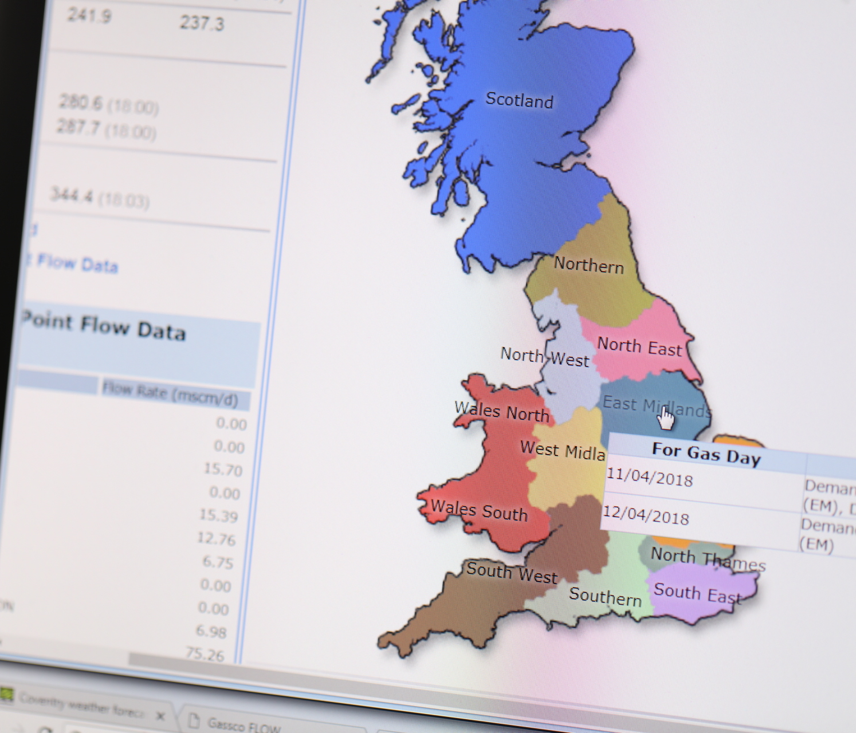
Future Engagement
Focus Group: Initial Focus Group went very well, next one scheduled for 20 November 2023. Material to be loaded on to Sustain Plus webpage.
Market Trials: Q2 2024, it is essential all companies that use Gemini participate in this activity. Details and invitation to participate will be issued later this year.
Training: 2024 (dates TBC), essential training will be provided in order to access and use the updated Gemini.

