Slide 1
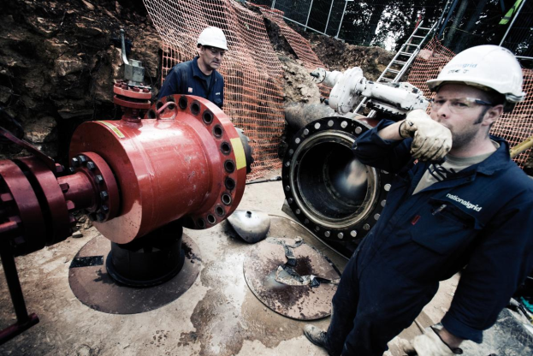
Gas Day Estimated Imbalance Cost Update
Workgroup 0541
10th November 2015
Notes:
1

Slide 2
Revised Analysis
The following ten sub-terminals have included in the analysis
Bacton Perenco, Bacton Shell, Bacton Seal, Barrow, Easington Dimlington, St Fergus Apache, St Fergus Shell, Teeside BP, Teeside PX and Theddlethorpe
The analysis covers 12 months between 1st Sep 2014 to 31st Aug 2015 inclusive.

Slide 3
Key Figures 1st Sep 2014 – 31st Aug 2015
In a ‘Do Nothing’ scenario, this is the estimated value of gas that would be classified as ‘unclaimed gas’. Revenue is then returned to all Shippers based on throughput via a reduction in the SO Commodity charge
Total SMP Buy Cashout Value | Total SMP Sell Cashout Value | Absolute Residual Imbalance Costs
£19,752,983 | £18,990,913 | £866,409
In a ‘Do Nothing’ scenario where CVSL are unable to scale up, this shows the total estimated value of SMP buy costs Shippers would be debited
Option A would permit Shippers’ claims to be scaled up and down according to the 5-5 DQ, leaving the absolute residual imbalance costs at ~£870k

