Slide 1
UK Link Programme ChC - PIS Approach Overview
(07/06/17)

Slide 2
Defect Fix Prioritisation
All Problem Records raised in SDP which relate to the need for a code or configuration change to a new UK Link application within the IT estate managed by Xoserve will see a solution defect raised in HPQC.
Each HPQC solution defect will, in isolation, be assessed against a number of pre-defined Severity and Priority variables to determine an overall “Fix Priority Score”.
It is this “Fix Priority Score”, along with a understanding of the fix effort associated with each defect (set by the relevant ARG Fix Lead) which will enable the Xoserve PIS Defect & Release Management team to propose the allocation of defect fixes to production release pots.
It is proposed that all defects in the PIS arena, newly discovered and the ~130x PGL deferred defect fixes, will undergo this “Fix Priority Score” determination to confirm the most suitable Release.
The proposed release of PIS defect fixes will be circulated in advance of the weekly DRG industry calls, whereby defect fixes allocated to a release may be challenged by exception.
New Defects
Fix Effort Determination
R1.01
Defect A Fix Priority Score %
R1.02
Severity/Priority Assessment
(Fix Priority Score Determination)
Defect B Fix Priority Score %
Defect C Fix Priority Score %
UKLP PGL
Deferred Defects
Defect D Fix Priority Score %
R1.03

Slide 3
Defect Fix Prioritisation
The following variables will be held as attributes in HPQC, for each defect, so that once set an algorithm can be processed to generate an overall “Fix Priority Score”.
Severity Variables (Business Impact)
Priority Variables (Fix Urgency)
Business Process Criticality
What is the primary business process for which the solution defect impacts, and how important is this business process?
Business Process Frequency
How frequent does the primary business process, for which the solution defect impacts, run in Production (Daily / Weekly / Monthly / Annually / Seasonal)
Direct External Impact?
Is the solution defect having a direct impact upon Xoserve’s customer base? (Yes/No)
Breach of UNC?
Is the solution defect causing Xoserve to potentially break their UNC contractual obligations? (Yes/No)
Gas Safety?
Is the solution defect potentially introducing a risk to Gas Safety? (Yes/No)
Direct End Consumer Impact?
Is it possible that the solution defect could have a likely impact upon the end-consumer in the immediate term? (i.e. switching)
Possible Workaround Available?
Is there a interim workaround available which will limit the impact upon current service levels arising from this solution defect? (Yes/No)
Workaround Involvement?
Assuming a workaround is available, who is required to perform such workaround steps? (Xoserve / Industry / Both).
Workaround Intensity?
How labour intensive is the workaround?
Workaround Complexity?
Is the workaround difficult to perform and therefore potentially not necessarily risk-free.
Workaround Lifespan?
Week / Month / Year / More than a Year
Need date for solution defect fix
What is the absolute drop-dead need date for the solution defect fix to be deployed to Production? Steer taken from Xoserve Business Ops/ARG teams.
Number of Incidents raised against Problem Record / Defect

Slide 4
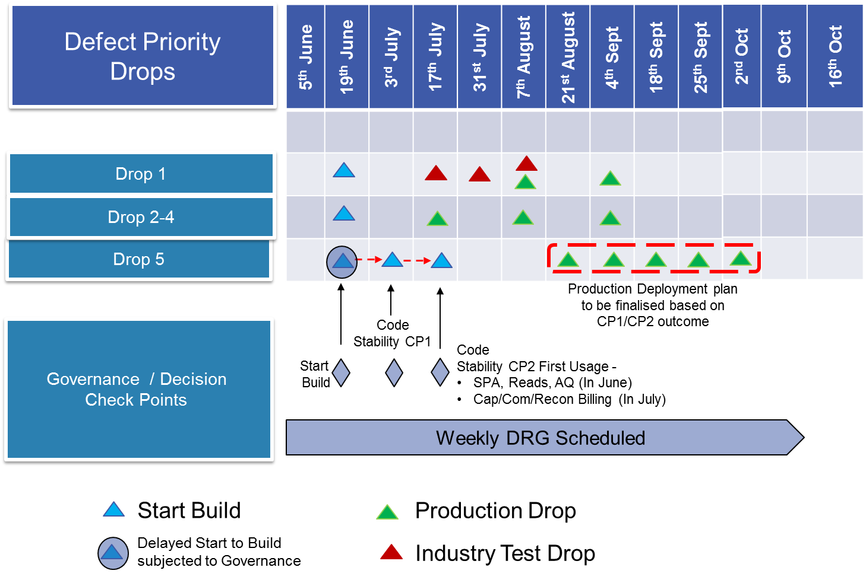
Release Management
Established Xoserve internal CAB process will NOT allow lower priority production changes to be deployed where there is NOT service stability.

