Slide 1
SoS Report
PAC – 13th December 2016

Slide 2
SoS Report
The SoS (standards of service) report is collated by Xoserve to detail performance against the TSLs (Transportation Standards and Liabilities) as set out in Modification Report -Transco Proposal for Revision of Network Code Standards of Service -Modification Reference Number 0565
Some of the standards refer to performance indicators by Xoserve, others refer to performance indicators by the transporters
At PAC on 8th November 2016 we were asked to explain the contents of the SOS report

Slide 3
SoS Report (2)
The SoS report used to be presented to the SoS Committee. In 2012 the SoS committee requested to meet once every 6 months, seeking approval of this change to the ToR at UNCC. The subsequent meeting in July was cancelled, the following meeting in January 2013 was not quorate. The Committee has not met since
During this time no questions have been raised with regards to the SoS report, however the final modification report for modification 565 was March 2003

Slide 4
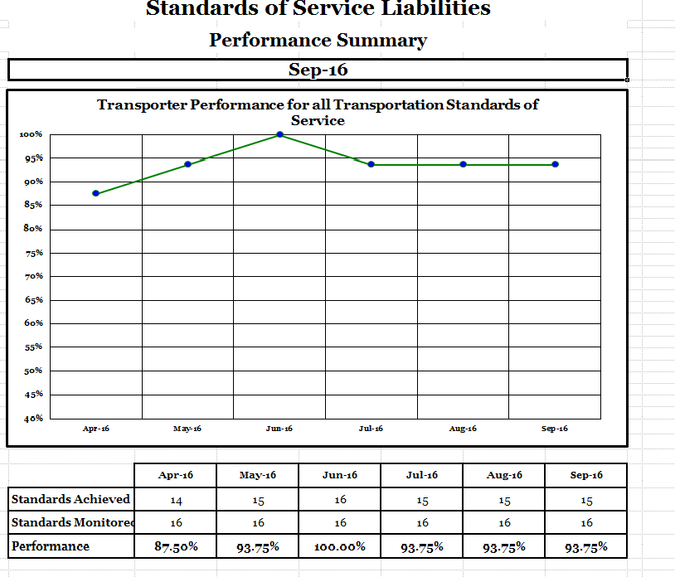
The front page is an overview
of the last 6 months of performance overall

Slide 5
Shadow Log
Shadow log – in the words of the modification “The shadow log should act to moderate User behavior and inhibit the generation of liability payments from Transco through inappropriate action (or inaction).”
The shadow log accounts for activity that may not be completed but is through no fault of Xoserve or the transporter for example with query management this is a invalid query (an address amendment that is rejected for not being PAF valid) and these are discounted from the standards and liabilities

Slide 6
TSL 1 - Daily Metered Reads
Original UNC ref: M5.2.1; this standard refers to the submission of Valid Meter Readings on Daily Metered (DM) Sites
Following on from mod 466AV – this is a standard of service (SoS) target - the planned performance level (PPL) is 100% by 12 noon (previously 97.5% in mod565 but amended through mod466AV) Liabilities are incurred based on rules around performance of failure rate (pofr)
This liability resides with the Transporters

Slide 7
TSL 2a and 2b – Calorific Values
UNC ref: C1.6; this standard refers to the provision of the Calorific Values within the timeframe (11:00am / 4pm – 2a) and the provision of revised CV values (D+5- 2b)
This falls under the Network Code Compensation (NCC) whereby liabilities are paid per failure of making this information available. This is £50 for the 11am /4pm target and £250 for the revision of a CV value. This liability resides with the Transporters.
Xoserve reports against this standard based on information received from the Transporter

Slide 8
TSL 3 & 4 – Suppressed Invoices
UNC ref E8.2.1: TSL 3 – suppressed invoices on DM sites, TSL 4 – suppressed invoices on Non-Daily Metered (NDM) sites. This refers to suppressed charges rather than suppressed invoices and can apply in situations i.e. MRUN. The charges need to be applied or removed within certain timeframes (1 month or 2 months).
This is an SOS target - the PPL is 98%
This standard is discharged through Xoserve

Slide 9
TSL 5 & 6 – Invalid Offers Large / Small
UNC ref: G4.2; this standard refers to payments related to rejected Supply Point Offers
This is a NCC liability whereby £50 is paid per failure. This liability resides with the Transporters
This standard was against query code IOC (invalid offers) in ConQuest; this ceased as a contact code when CMS was introduced therefore this is no longer relevant

Slide 10
TSL 7 – GRE Invoice Queries
UNC ref: S4.6; refers to a standard as agreed in modification 0385 (Standard of Service on Adjustments to GRE Invoice Queries) to respond to GRE invoice queries in a timely manner.
The liabilities for this NCC standard are variable
This standard is discharged through Xoserve

Slide 11
TSL 8a & 8b – Nominations Referred – Large / Small
UNC ref: G2.3.4; this standard refers to the nominations referred to the Transporters. Transporters are required to submit a Supply Point Offer.
The PPL is 97% within 12 business days
This liability resides with the Transporters
Xoserve reports against this standard based on information received from the Transporter

Slide 12
TSL 9a & 9b – Site visits
UNC ref: G4.3; this standard refers to the number of failed appointments for agreed site visits by the Transporter.
The PPL is 95%, the shadow log excludes site visits that are arranged and access is denied or no person present to allow access
This contact was previously completed in ConQuest through ASV Contacts. Following RGMA this is an obsolete standard

Slide 13
TSL 10a and 10c – File Formats Consultation / Implementation
UNC ref: U8.6.1; this standard refers to:
Notification of Class 2 and 3 changes for UK Link
Allowing a consultation process (representations)
Giving notice of the change for implementation (3 months)
Failing to notify of non implementation for any unsuccessful implementations within one business day
Liabilities are paid per failure of compliance. This standard is discharged through Xoserve

Slide 14
TSL 11a – Gas Not Available
UNC ref: J3.5.3; For sites with a threshold above 73,200kwh where gas is not available for a period of 24 hours liabilities are paid
The liabilities for this NCC standard are variable
These liabilities are paid in all circumstances of failure. This liability resides with the Transporters, the information is provided to Xoserve by the Transporter

Slide 15
TSL 12a & 12b – System Failure & System Recovery
UNC ref: U7.6.1; Where the UK Link system fails and the system recovery takes longer than 5 hours liabilities of £50 will be paid per User. This is increased by 100% for each subsequent failure within the business day, per User affected (12b). UK Link System Failure of 24 hours or more leads to a liability payment of £1000 per User (12a)
This is an NCC standard discharged by Xoserve. The shadow log for this covers where the system failure may be the result of User actions

Slide 16
TSL 13a-14d – Query Resolution
UNC ref: S4.7.1: relates to Query resolution
TSL: | Standard Name | Type | Liability
TSL13a | Query Resolution GT (I&C) <=4 days | SOS
TSL13b | Query Resolution GT (I&C) <=10 days | SOS
TSL13c | Query Resolution GT (I&C) <=20 days | SOS
TSL13d | Query Resolution GT (I&C) >=40 days | NCC | £70
TSL14a | Query Resolution GT (Dom) <=4 days | SOS
TSL14b | Query Resolution GT (Dom) <=10 days | SOS
TSL14c | Query Resolution GT (Dom) <=20 days | SOS
TSL14d | Query Resolution GT (Dom) >=40 days | NCC | £20

Slide 17
The Shadow log
It is presumed that Users submit queries in good faith but there are occasions when the query is deemed to be invalid (No challenge to the data or Shipper data incorrect). For Query Management it has been accepted that queries, which are deemed to be invalid, are to be used as the measure within the Shadow Log.
All Invalid queries are deducted from the total population on a 1 for 1 basis. The number of such queries will be classed as “shadow log relevant invalid Queries” for the calculation of any liability payments due.

Slide 18
Determination of User Limits
For each User an average daily limit is determined, based on the daily average of valid queries received each month. The total number of valid queries will be determined from the total number of queries submitted minus the number of invalid queries cleared in that month.
The daily average of any month will be calculated by dividing the total number of valid queries submitted each month per User, by the number of Business Days within the month.
The Current month daily limit will be taken to be the highest daily average within the preceding three months +20%. The limit will change month on month against the three month rolling highest figure

Slide 19
Example of User limits
Month | Business Days in month | Actual Total Queries | Actual Total Valid Queries | Valid Daily Average | Current Month Daily Limit (rounded up)
1 | 21 | 451 | 406 | 19.3 | -
2 | 21 | 500 | 450 | 21.4 | -
3 | 20 | 601 | 541 | 27.1 | -
4 | 22 | 482 | 434 | 19.7 | 33
5 | 21 | 467 | 421 | 20.1 | 33
6 | 20 | 593 | 534 | 26.7 | 33
7 | 21 | 397 | 358 | 17.1 | 32
Example - Current Month Daily Limit for month 4 = highest daily average from the preceding 3 months + 20 % 27.1 * 20% = 5.42 valid queries 27.1 + 5.42 = 33 daily limit

Slide 20
*
**
* Excesses are any number of queries > valid daily average amount ** Shadow Log is the Invalid queries
Final Achieved Performance (%) = No. of Queries resolved within D Days * 100
A – B – C
GT Large – 4 Day Target 80%
Final Achieved Performance (%) = 980 * 100 = 98,000 = 460%
1544 – 716 – 615 213
GT Large – 10 Day Target 95%
Final Achieved Performance (%) = 1517 * 100 = 151,700 = 925%
1544 – 765 – 615 164
GT Large – 20 Day Target 98%
Final Achieved Performance (%) = 1542 * 100 = 975%
1544 – 771 – 615
A = the total number of queries resolved within the month
B = the number of Shadow Log Relevant Invalid Queries
C = the sum of daily excesses
D = 4, 10 or 20 days respectively
The volume of Invalid queries and Excesses as a ratio to the number of queries received cause the excessive percentages

Slide 21
TSL 18a & 18b / 19a & 19b – Special Supply Points
UNC ref: M2.7.1; this standard relates to special supply points with the transporter required to complete the work and amend the supply point within timeframes:
This is a SOS, with a PPL of 95%. The liability amount increases should this activity not be completed within 20 days.
TSL18a | Special SP Amendment Large >5 days
TSL18b | Special SP Amendment Large >20 days
TSL19a | Special SP Amendment Small >5 days
TSL19b | Special SP Amendment Small >20 days

Slide 22
Changes to the SOS report
FGO removes all liabilities for the CDSP, however liabilities continue for Transporters.
SoS Reporting on performance will continue for both parties
Amendments to the SoS are being made in light of Nexus changes – for example with query resolution - USRVs will no longer be relevant whereas other contact codes may be
Any changes to modification 565 at present require extensive changes to code and reporting

Slide 23
Recommendation
The SoS report is already going through planned change.
Due to the current change congestion any further reporting or code changes are unlikely.
As PAC create a new performance regime we would recommend any old standards and liabilities fall away at that point in time i.e. through mod development
At present time we recommend that the SoS report is retained in its current form with a view to evolve

