Slide 1
0630R Review Group meeting 21 February 2018 Settlement Data topic
Disclaimer – the information provided on the Central Switching System (CSS) processes is an extract for the purpose of providing background to the 0630R topics under discussion today. The information does not represent the full extent of the CSS processes / business rules

Slide 2
Central Switching System Data items provided in switch request (gas only and only those relevant to 630R discussion)
Data item
Purpose / validations
RMP Id
Valid RMP Id
Supplier Id
Valid Supplier Id, sanction test
Switch Effective Date
Switch Effective Date – within D+28 and D+1
Shipper Id
Valid Shipper Id, valid Shipper:Supplier relationship. Shipper sanctions test
Market Sector Code
Valid Market Sector Code
Change of occupancy indicator
“Y” may nullify objection test.
Erroneous transfer indicator
“Y” nullifies objection test.

Slide 3
Phases of a switch request (happy path)
Switch request
Validated switch notice
Confirmed notice
Secured switch notice
17:00
00:00
Validated switch request
Objection*
window
Not objected
Gate
Closure
Switched
* Objection period (1 or 2 days) is determined by the prevailing RMP market sector code held in CSS, not the market sector code provided by the gaining Supplier in the switch request.

Slide 4
Notifications issued by CSS during a switch request (happy path) Source – Operational Choreography document: https://www.ofgem.gov.uk/system/files/docs/2017/10/d-4.1.6_e2e_operational_choreography_v3.0_daft_final.pdf
Gaining Supplier
Gaining Supplier
Gaining Supplier
Outgoing Supplier
Outgoing Supplier
Outgoing Supplier
Gaining Shipper
Gaining Shipper
Gaining Shipper
Outgoing Shipper
Outgoing Shipper
Outgoing Shipper
UK Link*
UK Link
UK Link
Data Enquiry Service
Data Enquiry Service
Data Enquiry Service
Switch request
Validated switch notice
Confirmed notice
Secured switch notice
17:00
00:00
* - under review

Slide 5
Phases of a switch request validation failure
Switch request
Failed validation – switch cancelled
17:00
00:00
Validated switch request

Slide 6
Phases of a switch request objection
Switch request
Validated switch request
Objected – switch cancelled
17:00
Validated switch request
Objection
window

Slide 7
Phases of a switch request cancellation
Incoming Supplier cancels Switch request
(can happen up to 17:00 D-1)*
Switch request
Validated switch notice
Confirmed notice
17:00
00:00
Validated switch request
Objection
window
Not objected
* Notices sent to industry parties as required

Slide 8
Phases of a switch request annulment
Losing Supplier annuls Switch request
(can happen up to 17:00 D-1)*
Switch request
Validated switch notice
Confirmed notice
17:00
00:00
Validated switch request
Objection
window
Not objected
* Notices sent to industry parties as required

Slide 9
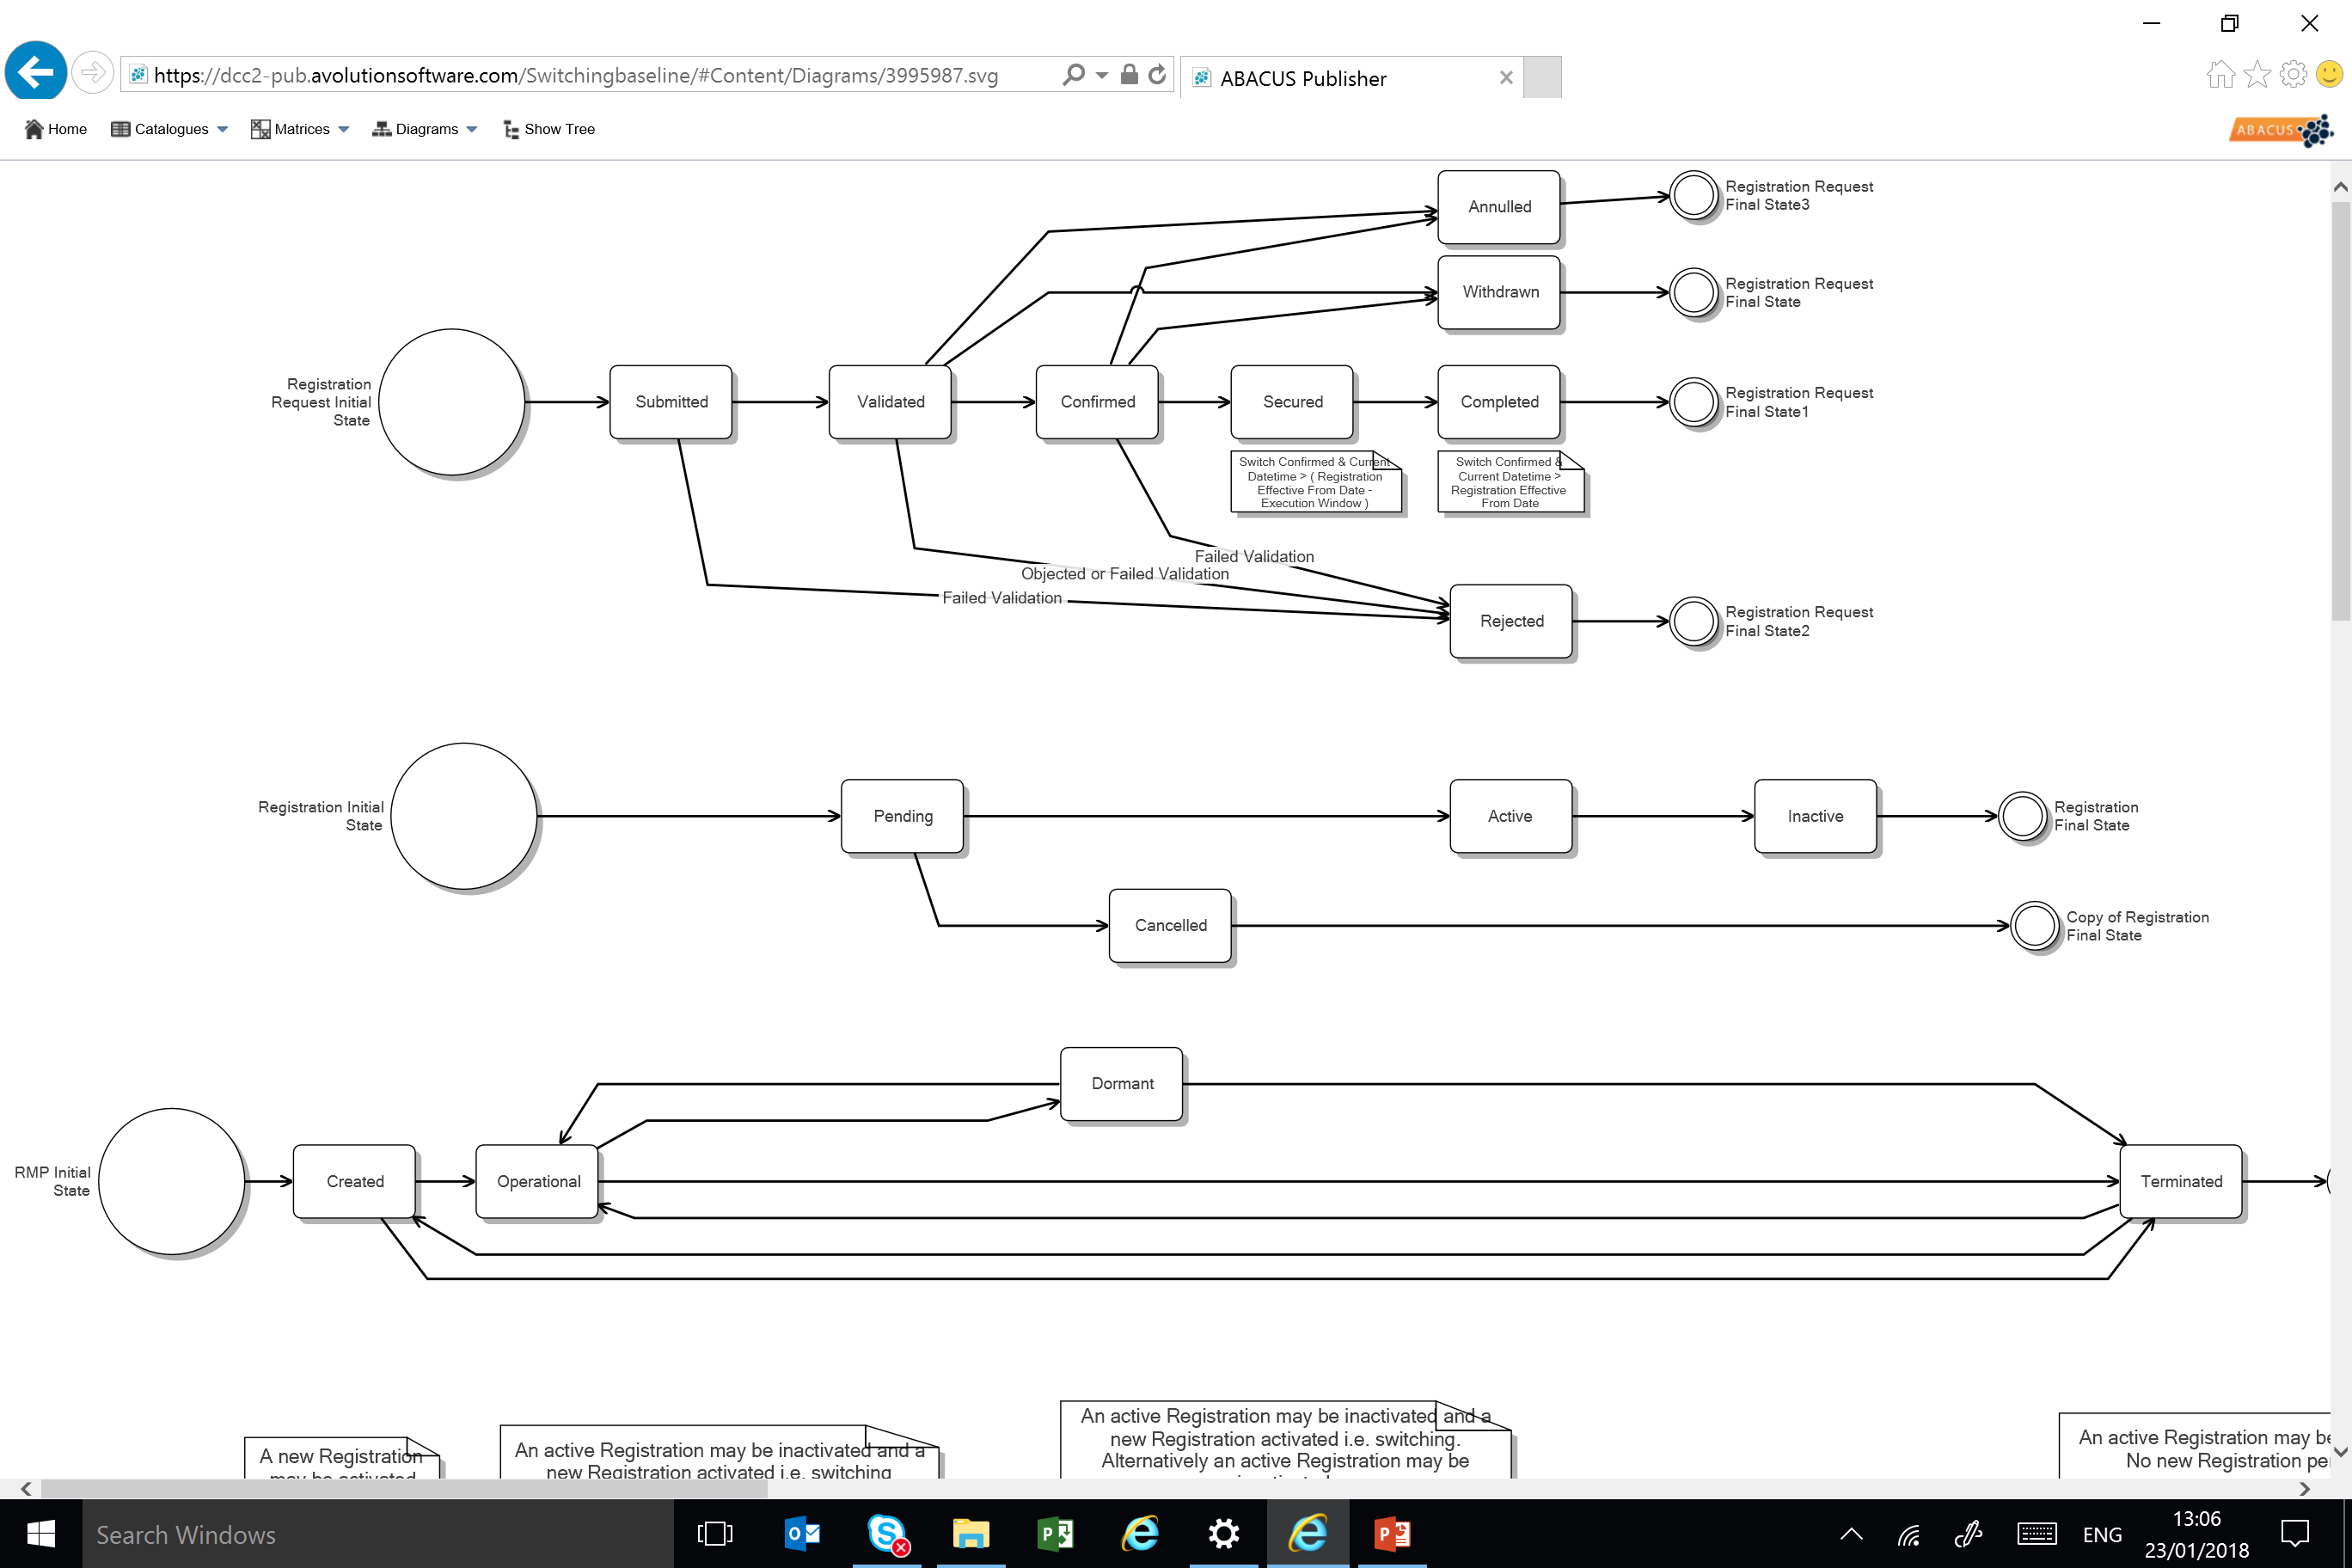
Registration rules and status – from ABACUS

Slide 10
Data items provided in UK Link change of Shipper / registration event to establish settlement criteria - Grey shading indicates not provided by CSS
Class 4
Class 3
MPRN
MPRN
Shipper Id
Shipper Id
Supplier Id
Supplier Id
Switch Effective Date
Switch Effective Date
Market Sector Code
Market Sector Code
Class 4
Class 3
Meter reading frequency
Read submission frequency
Customer / supply point data e.g. emergency contact details
Customer / supply point data e.g. emergency contact details

Slide 11
Data items provided in UK Link change of Shipper / registration event to establish settlement criteria - Grey shading indicates not provided by CSS
Class 2
Class 1
MPRN
MPRN
Shipper Id
Shipper Id
Supplier Id
Supplier Id
Switch Effective Date
Switch Effective Date
Market Sector Code
Market Sector Code
Class 2
Class 1
Meter reading frequency
Read submission frequency
SOQ
SOQ
SHQ
SHQ
Customer / supply point data e.g. emergency contact details
Customer / supply point data e.g. emergency contact details

Slide 12
Discuss…………….
Solution options:
“shell” record
Default rules
others

Slide 13
Isolation and withdrawal discussion topic

Slide 14
Discussion topic Isolation and withdrawal – UNC rules
The table on the following slide sets out the rules to be met in order for the Registered User to withdraw from a Supply Point.
With the implementation of the CSS rules need to be established to ensure that Supplier registration / withdrawal to a RMP and Shipper registration / withdrawal to a Supply Point are consistent e.g. it cannot be the case that a Shipper is registered to a Supply Point without a Supplier being registered to a RMP – so a Supplier cannot withdraw from a RMP without the rules in the UNC being met.

Slide 15
Discussion topic Isolation and withdrawal – UNC rules
Meter Point Status (status of the service pipe) | Isolation status (the ability of the meter to pass gas) | Withdrawal status | Confirmation status | RMP status (as held by CSS)
LI | N (or blank) | N | LI | Operational
LI | Y | N | LI | Dormant
LI | N (or blank) | Y | LI | Operational
LI | Y | Y | SU | Dormant
CA or CL | N (or blank) | N | LI | Operational
CA or CL | Y | N | LI | Dormant
CA or CL | N (or blank) | Y | SU | Operational
CA or CL | Y | Y | SU | Dormant
DE | N (or blank) | N | LI | Terminated
DE | Y | N | LI | Terminated
DE | N (or blank) | Y | SU | Terminated
DE | Y | Y | SU | Terminated
EX | Y | N | LI | Terminated
EX | Y | Y | SU | Terminated
EX | Nil value | Y | SU | Terminated

Slide 16
Discussion topic Isolation and withdrawal – REC / UNC rules
For a Supplier to withdraw from a RMP the following UNC rules must be met:
Isolation Status is Y
The Supplier withdrawal from the RMP automatically results in the Shipper withdrawal from the Supply Point.
A Shipper cannot independently withdraw from a Supply Point. A Shipper withdrawal from a Supply Point can only be initiated by a Supplier withdrawal to the RMP (which is subject to the rules above).

Slide 17
RMP status – from ABACUS
Dormant
RMP Status
Created*
Operational
Terminated
* Electricity status only

