Slide 1
TransformUs programme
DSC Change Management Committee
IX Changes Update
March 2018

Slide 2
IX Changes Update
Change of network service provider from Vodafone to Gamma as part of the separation from National Grid
The current contract has also ended – change of supplier highly likely even without separation
All current HW, except new or recently upgraded sites, is five-seven years old and needs to be replaced as ‘end of life’

Slide 3
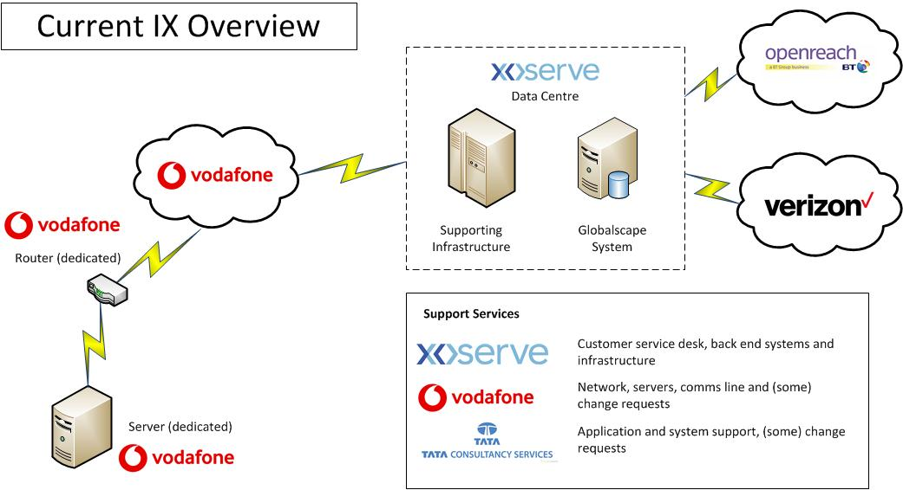
IX Changes Update: current service

Slide 4
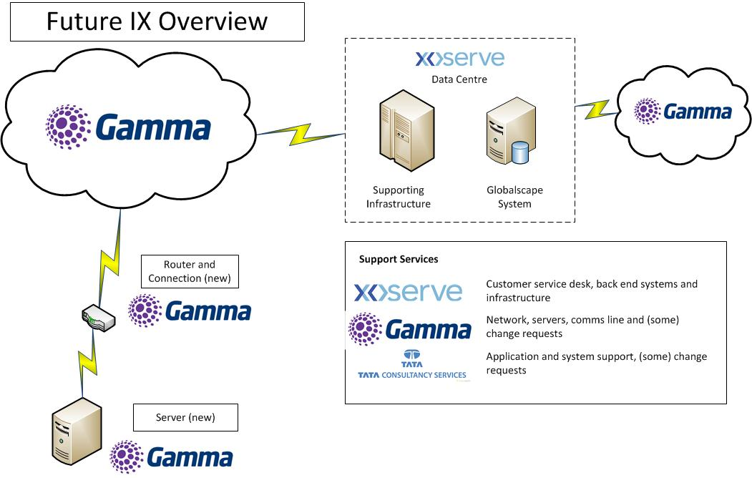
IX Changes Update: future service

Slide 5
IX changes - plan
Indicative Timescales
Design, build and test - February to end of March
Pilot site deployment and testing of new services – April to June
Full deployment (all customers) – June to September
Lessons learnt from previous IX roll outs
Access to customer sites
Clear plan of roll out
Clear processes to support the above
Customer centric, customer facing approach

