Slide 1
UNC Modification 0663S Extending the data comprised under the definition of Supply Point Premises Data (TPD V5.18.1) and iUNC Modification 114 Extending the data available to Suppliers under K24.3(l)

Slide 2
Background
RP0 | RP1 | RP2 | RP3
No system or process changes. No Improvement to reliable switching. 21 day switch. | Use existing systems. Address matching to improve reliability. Key Process changes (harmonised where possible) to deliver 3 to 7 day switch. | New central switching service (core data). Enduring reliability improvement to data quality. Harmonised and simplified next day switching process. | New central switching service and market intelligence services. Enduring reliability improvement, and improved access to broader range of switching data. Harmonised and simplified next day switching process.
The Ofgem Switching Programme set out 4 reform packages:
Do nothing
Enhance existing
CSS
CSS and MIS
As a result of the consultation Ofgem refined option 2 and the new option became 2A, and determined that the industry was best placed to develop and fund the MIS services
Ofgem then asked Xoserve and Gemserv to take forward the MIS initiative

Slide 3
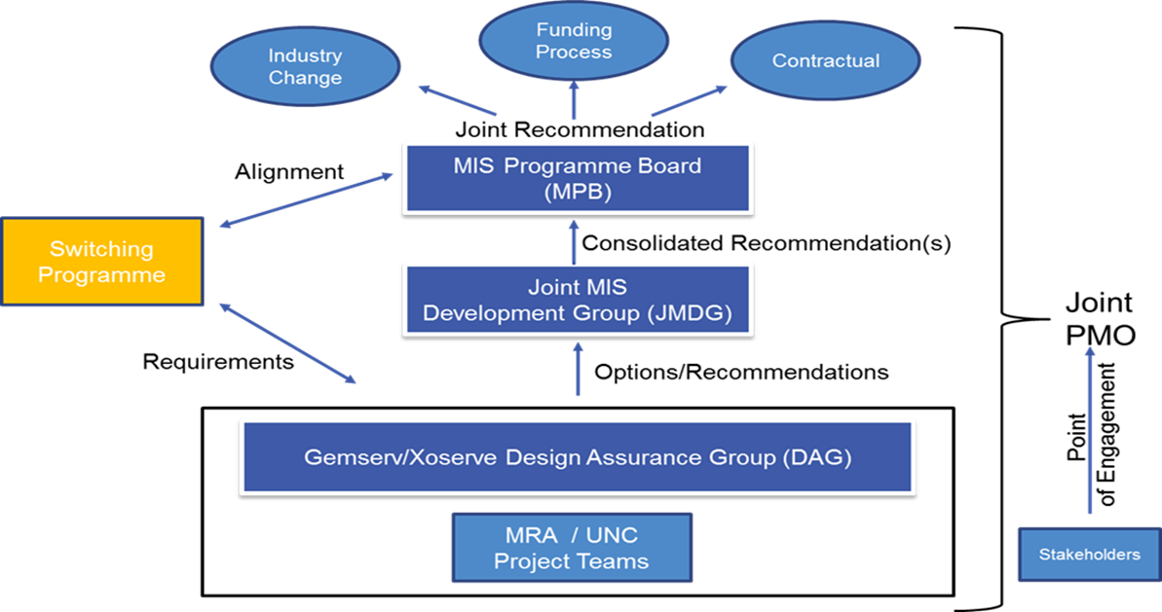
Governance
Gas representation established under the Data Services Contract Change Management Committee

Slide 4
Modifications 0663S and 114
JMDG developed use case for Supplier access to gas and electricity data via API
Purpose to support Suppliers in:
Provide quotation services to customer
Improve the quality of the switch request into UK Link
Improved creation of customer account on Supplier records
JMDG recommended service to MIS Programme Board
MIS Programme Board agreed and approved
MIS Programme Board (gas) sponsoring UNC modification to give effect to use case delivery
Modification required to permit release of data to Suppliers

Slide 5
Modifications 0663S and 114
Prepared along same lines as Modification 0640S and 106: Provision of access to Domestic Consumer data for Suppliers
Commercial arrangements same as developed under Modification 0640S and 106S
Extension of data items and to non-domestic data
Mod limits permission to Suppliers, not PCW or TPI

Slide 6
Data items
This modification proposes to extend access to the following data items:
Unique property reference number (where held),
CSEP identifier,
Transporter identity,
Transporter effective from date,
Current supplier name,
Formula Year Annual Quantity,
Supply Meter Point system offtake quantity,
Formula Year Supply Meter Point system offtake quantity,
Supply Meter Point system hourly quantity,
Supply Meter Point status,
Supply Point Withdrawal status,
Market Sector Code,
Existence of Interruption,
Classification of Twin-Supply Meter Point,
Meter type,
Meter status,

Slide 7
Data items
Meter number of dials,
Meter imperial indicator,
Isolation status,
Meter Asset Manager short code,
Incoming supplier,
Latest Meter Reading,
Meter Reading date,
Meter Reading type,
Smart meter system operator identity,
Smart meter system operator effective from date,
Data Communications Company service flag,
Data Communications Company service flag effective from date,
Identity of the installing supplier of the smart meter,
Smart metering equipment technical specification installation date,
In home display installation status,
Automated meter reading indicator,
Automated meter reading service provider identity.

Slide 8
Data items under 0640S and 106 for reference
• Supply Meter Point Reference Number,
• supply point address,
• Meter Post Code,
• Current supplier ID,
• meter mechanism code,
• network operator,
• meter capacity,
• meter serial number,
• Annual Quantity,
• Local Distribution Zone,
• Smart Meter Equipment Technical code.

