Slide 1
Gas Energy Measurement in Consumer Billing
Presentation to UNC Workgroup 0693R
25/02/2020

Slide 2
Overview
Background
Request by Ofgem
Two studies undertaken – different, but related
Approach taken
Key results
Implications for shrinkage

Slide 3
Background
In January 2014, Ofgem requested technical support in two areas:
Accuracy of thermal energy determined within the Gas (Calculation of Thermal Energy) Regulations and the impact on domestic gas consumers
Assessing the consumer impact of relaxation in accuracy of CV determination devices used to determine the CV of biomethane injected into gas distribution systems
Two different studies, but
Both related
Both may have significance in shrinkage calculations
Report was published on Ofgem’s website
Follow-up discussions between Ofgem and another party

Slide 4
Approach taken
Accuracy of consumer billing
Mathematical model of consumer billing
Estimate the error in energy determined for three groups of consumers on each day of 2011:
GB as a whole
The 13 charging zones/LDZs
The 2564 GB outcodes
Output from the model:
365 estimates of error in daily energy for each of the three groups
Uncertainty in each estimate of daily energy

Slide 5
Approach taken
Accuracy of biomethane CVDDs
Mathematical model of daily charging area CV (FWACV)calculation
Estimation the uncertainty in the daily charging area CV
Output from the model:
FWACV and uncertainty in FWACV for all LDZs for each day in 2011
Explored impact of biomethane flows whose energy wa determined with CVDDs of varying accuracy

Slide 6
Results
Accuracy of consumer billing study
GB as a whole, mean error in annual energy during 2011
$$−0.238\% ±0.019\%$$
GB as a whole, mean error in daily energy during 2011
$$+0.6\% ±3.6\%$$

Slide 7
Results
Accuracy of consumer billing study
GB as a whole, mean error in annual energy during 2011
$$−0.238\% ±0.019\%$$
GB as a whole, mean error in daily energy during 2011
$$+0.6\% ±3.6\%$$
This represents variation in geographical and meteorological factors seen across GB

Slide 8
Results
Accuracy of consumer billing study
GB as a whole, mean error in annual energy during 2011
$$−0.238\% ±0.019\%$$
GB as a whole, mean error in daily energy during 2011
$$+0.6\% ±3.6\%$$
Mean error in annual energy is reduced because individual daily errors tend to be negative during Autumn/Winter (when gas consumption is higher) and positive duing Spring/Summer (when gas consumption is lower).

Slide 9
Results
Accuracy of consumer billing study
GB as a whole, mean error in annual energy during 2011
$$−0.238\% ±0.019\%$$
GB as a whole, mean error in daily energy during 2011
$$+0.6\% ±3.6\%$$
Uncertainty in error in annual energy is reduced because seasonal variation is removed.

Slide 10
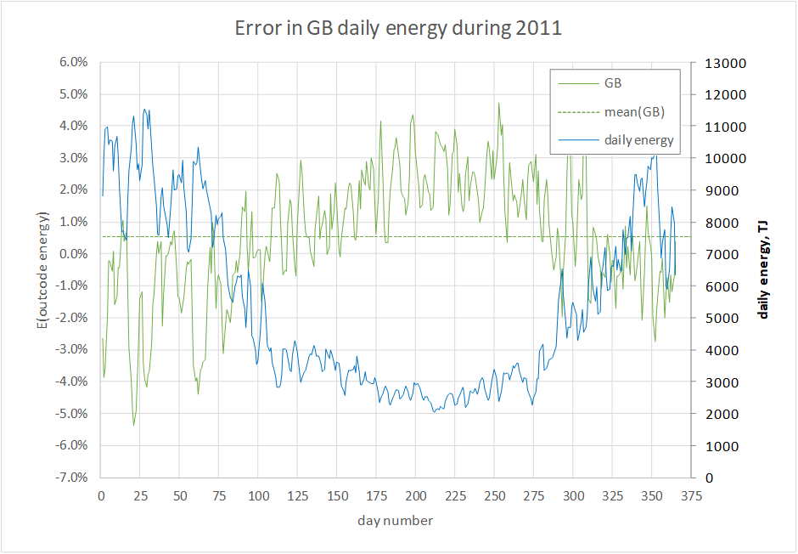
Dominated by distribution in errors

Slide 11
Temperature and pressure dominate

Slide 12
Results
Accuracy of consumer billing study
Use of a single fixed factor necessarily results in over-/under-billing of groups of consumers
Outcode level:
$−1.569\% ±0.021\% \left(PE11\right) to+2.477\% ±0.016 (BD6)$
Use of alternative fixed factors would have corrected the mean error, but at the expense of increased over-billing
Use of LDZ-specific fixed factors would have reduced the width of the distribution of errors in energy, but largely by reducing under-billing (over-billing largely unchanged)
Some benefit from incorporating mean height at each outcode

Slide 13
Results
Accuracy of biomethane CVDDs study
Expanded uncertainty in daily charging area CV estimated to be around
$±0.08MJ/m^{3}$ (or 0.2%)
Because biomethane sites are expected to be a relatively small proportion of daily energy, the impact of accuracy in their determined daily energies is relatively minor
Values for maximum permissible errors suggested for different threshold flows
Applicable to any gas, not just biomethane

Slide 14
Implications for shrinkage
Accuracy of consumer billing
UIG = energy output – energy input
Errors in energy output contribute to error in UIG (same sign)
Accuracy of energy input metering
Errors in energy inputs also contribute to error in UIG
Are input errors significant?
Estimates of uncertainty in determined UIG?
Shippers’ portfolios are another group of consumers
Distribution in geography and meteorological factors
Large portfolios might be expected to even out

