Slide 1
Alternative to UNC779
“Introduction of Entry Capacity Assignments with Defined End Date”
 | UNC779 | Alternative to UNC779 – what’s the difference?
What? | Provides the ability to assign Capacity at Entry Points Any volume from 1 kWh/day Assignment period is from a defined start date and runs to the end of the contract | Provides additional flexibility by allowing for the assignment period to be shortened with a defined end date instead of always running by default to the end of the contract
Why? | Allows parties who exit the market to reduce their administrative burden and risk whilst providing an alternative to short-term auctions for new entrants Enables benefits and discounts associated with holding both the capacity and liability simultaneously Gives Users another tool with which they can better manage their portfolios, and give National Grid NTS more reflective long-term capacity booking signals | Better achieves objectives 2 and 3 because it: Provides Users with access to additional primary capacity for a limited period to fit their requirements, including when there is little or no remaining capacity available in auctions More comprehensive tool for Users to manage their portfolios and improves short and medium term capacity booking signals for National Grid NTS
How? | No suggested implementation date Excludes day ahead, within day and weekly contracts No minimum notice period proposed, but for Exit Assignments the notice period is 5 Business Days Assignee pays the published Entry Transmission Services rate | Suggested target implementation date October 2022 Includes weekly contracts

Slide 2
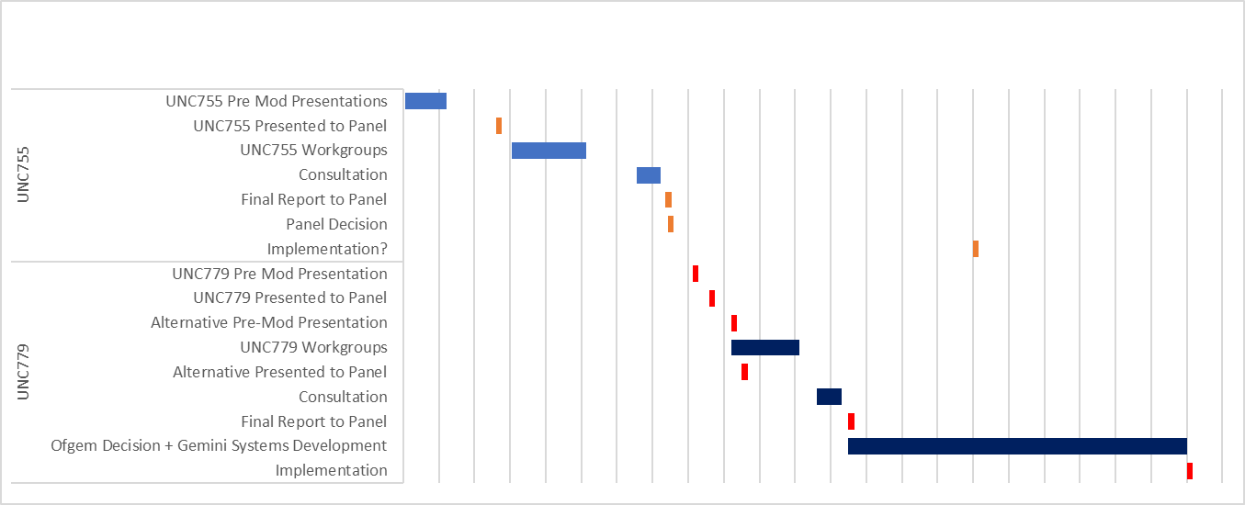
Alternative to UNC779
Proposed Timeline Compared with UNC755S (Exit Capacity Assignments)
The UNC779 Original proposes 6 months of workgroups. This alternative timeline proposes 3 months of workgroups in total for the UNC779 solution, including today (7 Sept) where the alternative features as a pre-mod. This would be the same number of workgroups as UNC755. Four workgroups in total would result in a Christmas period/delayed consultation.
Timescale for implementation is likely to be dependent on lead time for Ofgem decision plus Gemini development

