Slide 1



Pre-mod discussion: Treatment of Capacity at Combined ASEPs
6 July 2017

Slide 2
Treatment of Capacity at Combined ASEPs
Mod on treatment of capacity at combined ASEPs
  Some ASEPs may have multiple classifications of capacity (e.g. beach and storage or LNG entry)
  Discounts allowed under Art 9 of TAR NC for certain classifications
Compliments UNC 0621 on “Amendments to Gas Transmission Charging Regime”
Deals with treatment of capacity rather than how specific charges are set (hence a separate mod from main charging review mod)

Slide 3
Treatment of Capacity at Combined ASEPs
Proposed Timetable
  Pre-Mod discussion 6 July 2017
  Sent to Panel 20 July 2017
  Initial Consideration by Workgroup 3 August 2017
  Workgroup Report presented to Panel 21 December 2017
  Draft Modification Report issued for consultation 21 December 2017
  Consultation Close-out for representations 01March 2018
  Final Modification Report available for Panel 05 March 2018
  Modification Panel decision 15 March 2018

Slide 4
Treatment of Capacity at Combined ASEPs
The Modification proposal shall seek to introduce a mechanism to identify capacity classifications in order to apply relevant discounts within combined ASEPs (e.g. has both beach and storage or LNG entry points)
Facilitates Art 9 of TAR NC which allows discounts for certain capacity classifications

Slide 5
Treatment of Capacity at Combined ASEPs
Modification shall propose mechanism to differentiate between capacity types
National Grid shall propose to
  Split any combined ASEP and create new points that are eligible for any discounts
  OR
  Keep the ASEP whole but have a methodology to identify capacity associated with classifications eligible for the discounts
National Grid open to either approach

Slide 6
Treatment of Capacity at Combined ASEPs
Points to consider
  How does Art 35 (existing capacity) impact combined ASEPs?
  If ASEP is split should an aggregate overrun regime apply to allow shippers to flexibly flow through each new point created from the original combined ASEP?
  If keep ASEP whole how to identify different classifications – e.g. allocated flows?

Slide 7
European Update
6 July 2017

Slide 8
1. General Update

Slide 9
Code Status Update
Code | Current Status | Implementation date
Tariffs (TAR) | Entered into Force 6 April 2017, Mods now being raised (e.g. UNC 0621 + combined ASEP Mod) | Applicable from 6 April 2017, 1 October 2017, 31 May 2019.
Transparency (TRA) | Entered into Force 6 April 2017 | Applicable from 01 October 2017, First publication end 2017
CAM amendments | Entered into Force 6 April 2017 | Applicable from 6 April 2017

Slide 10
Draft Indicative Timeline – National Grid Gas
2016
2017
2018
2019
Q3
Q4
Q1
Q2
Q3
Q4
Q1
Q2
Q3
Q4
Q1
Q2
Q3
Q4
Comitology
Annual Yearly Auction
(6th Mar)
NG Process /
System
Entry into Force 6 April 2017
Consultation
Mod Panel Decision
First Quarterly Auction (Aug)
Annual Yearly Auction (July)
Annual Yearly Auction (July)
CAM Amendments
(Mod 598s)
Modification Devt.
Implemented 6 April
Business Rule
Devt.
Comitology
Demand Assessment
Starts
NG Process /
System
PARCA
Demand Assessment Report
(June)
Consultation
(Nov)
Project Proposal
(Feb)
Reservation of Capacity
Entry into Force 6 April 2017
Joint Notice
Modification Devt.
Consultation
Incremental
Capacity
(Mod 597)
Implemented 6 April
Licence
Changes
Consultation
13 Apr
to 16 May
Business Rule
Devt.
Consultation
13 Apr – 16 May
Report Issued 30th May
Ofgem
Decision
Methodology
Statements
Draft
Changes
Internal
Review
Statements
Effective July
EU Consultation processes
(Ofgem/NG?)
Entry into Force 6 April 2017
Comitology
NG Process /
System – early consideration of potential impacts
Mod 0611 Devt
including consultations
Licence Changes
Ofgem
Decisions
TAR Network Code
Pre Mod(s) Modification Devt.
Ofgem Decision
Business Rule
Devt.
Combined ASEPs Mod including consultation.
EU Processes assumed to follow in sequence from UNC processes
Ofgem Decision
May Implementation
Impact
Assessment to cover TAR/ Charging?
NTS CMF / Sub Group Workgroups – to develop and scrutinise options + Devt
May Implementation (codes / processes)
Amendments to the Gas Charging Regime
(Mod 621)
NTS CMF Workgroups – monthly – ongoing throughout
Pre Mod(s) / Mod Devt.
Licence Changes ?
EU Processes assumed to follow in sequence from UNC processes
Possible Ofgem Revised Decision?
Oct Implementation for price changes
Modification(s) Devt including consultation(s), etc.
Ofgem Decisions

Slide 11
Draft Indicative Timeline – National Grid Gas
2016
2017
2018
2019
Q3
Q4
Q1
Q2
Q3
Q4
Q1
Q2
Q3
Q4
Q1
Q2
Q3
Q4
Comitology
Consultation 17Aug to 7 Sep
Mod Panel Decision 21 Sep
ENTSOG Conversion Model finalised
Business Rule
Devt.
Entry into Force
(1 January 2018)
CAM Amendment
Capacity Conversion
(Mod 616s)
Mod Devt.
NG Process /
System
Transitional arrangement
Transparency
Pre Mod(s) Modification Devt.
May Implementation
Mod for Transparency for 2018
Ofgem Decisions
Aug Implementation
Last updated: 28/06/17

Slide 12
2. EU Code Updates

Slide 13
Tariff Code Update

Slide 14
ENTSOG Activities for remainder of 2017
October 2017: 2nd Implementation Workshop and updated Implementation Document
Internal Workshop between TSOs and ACER/NRAs
  Topics discussed:
    Cost allocation assessments
    Capacity-weighted distance methodology
    Multipliers and seasonal factors
    Ex-post compensation
    Payable price
Implementation & Effect Monitoring reports

Slide 15
ENTSOG Planned Activities for 2018
Support implementation of TAR NC
Monitor and analyse implementation of TAR NC
  Effect on the harmonisation of applicable rules aimed at facilitating market integration
Provide advice/guidance to TSOs and stakeholders
Facilitate knowledge and good practise sharing
Produce both implementation and effect monitoring reports with ACER for March 2018

Slide 16
ENTSOG Planned Activities for 2018

Slide 17
Implementation Monitoring
Gas Reg obligation on ENTSOG to “monitor and analyse” implementation of EU Codes
TAR NC Implementation Monitoring Questionnaire has now been developed
First report based on status as of 31 December 2017
Part A covers: Ch1. General Provisions, Ch5. Pricing of bundled capacity and capacity at VIPs, Ch7. Consultation requirements, Ch10. Final Provisions, Ch6. Clearing and payable price
Part B covers: Ch8. Publication requirements

Slide 18
Effect Monitoring
The impact of the implementation of the TAR NC will be monitored via 4 key indicators (draft):
  IND 1 (Regulatory Account)
    Level and volatility of RA
  IND 2 (Tariff Changes)
    Evolution between tariff periods
  IND 3 (Change in RPM)
    Description of current RPM and RPM changes
  IND 4 (Evolution of ST-LT Bookings)
    Changes at CAM points

Slide 19
UNC MOD 0621: Amendments to
Gas Charging Regime
Modification discussed at NTSCMF
  http://www.gasgovernance.co.uk/0621
Gas Charging Review incorporates EU TAR NC
One consolidated modification
  Interactions difficult to separate
  To enable alternates
  To facilitate easier decision making for Ofgem
Must be implemented by May 2019 (EU TAR NC), prices impacted from October 2019

Slide 20

EU Gas Regulatory Change Programme
EU Change 2017 – CAM, Incremental
& Transparency

Slide 21

August 13th Implementation
Gemini Implementation is scheduled for Sunday 13th August
After further analysis it has been confirmed that an extended Gemini outage is NOT required
All the implementation activities will now take place in the planned Gemini Maintenance Window (03:00-05:00)
If you experience any system issues please use the existing Xoserve Gemini Service Desk contact number
Please contact the NG EU Gas Regulatory Change team via email for any other issues relating to these changes
box.gasops.businessc@nationalgrid.com
Notes:
Project completed

Slide 22

Next Steps
We will continue to communicate with the industry through in the following channels:
          Gas Ops Forum
          Transmission Workgroup
          EU Gas Regulatory Change E-Mail Distribution List
Gemini Screen Pack has been circulated to UK Link
Committee and to contacts on the NG distribution list
User Guidance will be developed and circulated
prior to go live
Reminder regarding NIFR Webinar will be circulated
box.gasops.businessc@nationalgrid.com
Notes:
Project completed

Slide 23
Future Topics

Slide 24
Future Topics
Topic Area | Provisional Date
Tariffs Code | Monthly updates
Transparency requirements | Monthly updates
CAM Amendment | Monthly updates
Incremental | Monthly updates

Slide 25
Modification 0616S - Capacity Conversion

Slide 26
ENTSOG CC model - Recent Timeline of Events
Industry consultation – 14th April – 5th May
Amended model submitted to ACER – 18th May
Preliminary ACER comments received – 8th June
ENTSOG-ACER joint t-con – 20th June
Final version of model proposed – 27th June
Board approves final version – 5th July

Slide 27
Proposed changes to
ENTSOG model after ACER feedback
No fundamental changes.
Further clarifications and examples added in.
Note: More slides to follow before WG

Slide 28
Next Steps (slide from June WG as placeholder – more slides to follow)
3 feasible options regarding rules for legacy capacity and trading
Option | Legacy or Unbundled | Validate against Registered Capacity or net Entitlements | Allow conversion of traded in cap.
1 | Legacy Only | Registered | No
2 | Any Unbundled | Registered | No
3 | Any Unbundled | Entitlements | Yes
Industry feedback sought on options
Additionally NG will be engaging with Xoserve regarding the whole process, including above options
Considering information received in above 2 points, NG will bring a firm proposal to next WG

Slide 29
AOB

Slide 30


NETWORK INNOVATION COMPETION Project:
Customer Low Cost Connections (CLoCC)
Project CLoCC
Customer Low Cost Connections
Nicola Lond
Commercial Lead

Slide 31
Project CLoCC – Objectives for today
    Overview of Project CLoCC
What are potential Commercial Changes?
    Next Steps

Slide 32
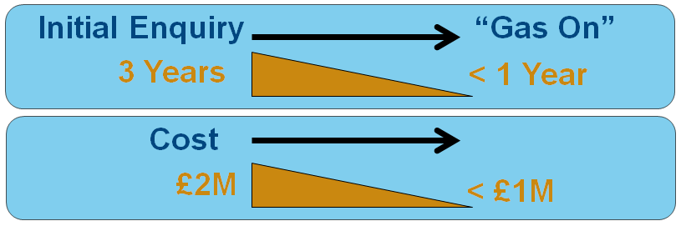
Project CLoCC – Core Objectives
    Engaging with key stakeholders now -
    Aiming to deliver by October 2018
Facilitating demand for connection of lower flows to NTS

Slide 33



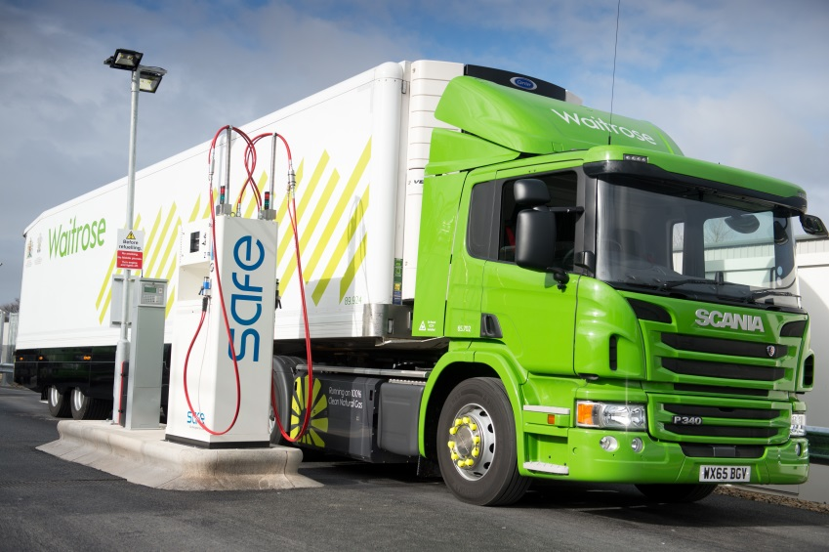
Decarbonising the Network
Notes:
ENABLER - CLoCC is well positioned as an enabler for other industry strategies that are looking at decarbonising the energy mix.
Aside from the obvious benefits of supporting indigenous gas supply and the reduced carbon footprint of producing energy on our doorstep, the project has also been working to utilise the Renewable Telemetry Kiosk. Offering customers the opportunity to produce electricity through use of solar panels and a wind turbine.
The project also has also been working to greatly simplify the design of an NTS exit connection, through this the hope is that gas fuelling stations may become more economical to develop to support development of Gas in Transport.

Slide 34


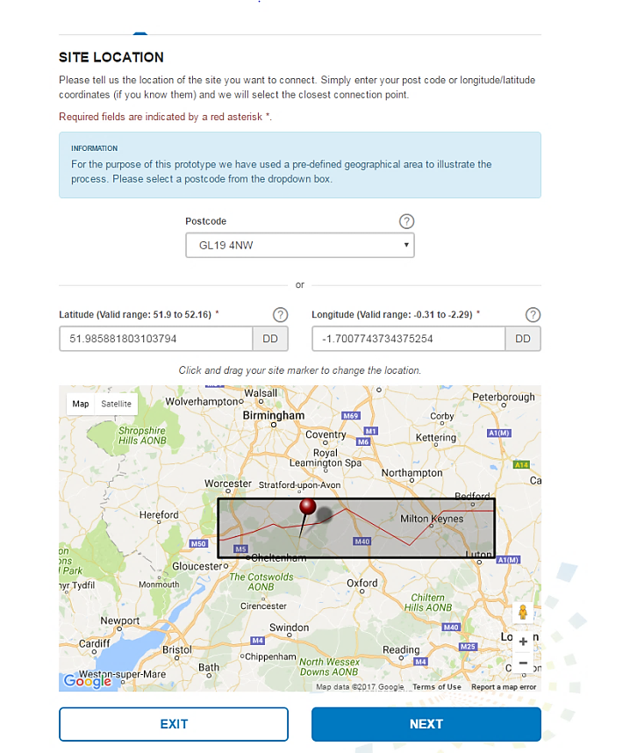
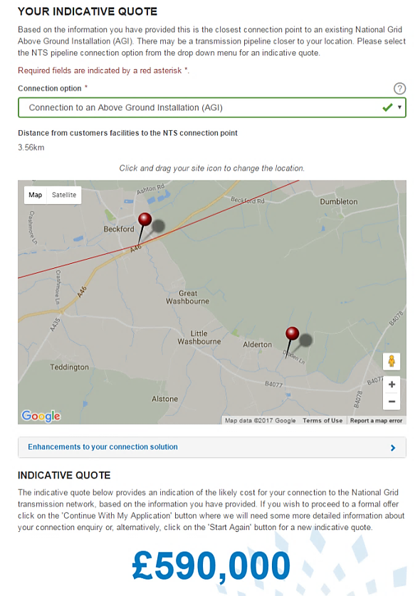
New Online Customer Connections Portal
Notes:
Online Portal will be available for all customers to use for connection Applications.
Here are some examples from a prototype created for our customers illustrating what we are aiming to achieve.
You can start by applying for a connection inputting various parameters such as connection type is it entry or exit, location – latitude longitude and flow rates.
Position is need to identify closest AGI or NTS feeder
Flow rate is key for sizing the skid correctly on site

Slide 35
CLoCC response to Customer Feedback
Customer Comments | Project CLoCC Action
NTS connections take too long & too expensive | Deliver connection solutions within 12 months & Less that £1m
We’d like more predictable costs | Developed a suite of standardised connections designs that will be pre-approved and pre-appraised
We would like to be offered more services than just a Minimum Offtake Connection | Looking to make filtration and metering options available for our customers
Why do I need an ROV on my connection? | Reviewing the ROV requirement for exit connections that meet our risk assessment criteria – this will help reduce connection costs
Why is the application fee so large? | Developing options for making applications through the connections portal cheaper
More payment flexibility would be very useful | Looking at introducing the ability to phase payments
We’d like to have more information on our connection progress | Incorporated customer “status” updates into our new online connections portal
We need capacity and connection application processes better aligned | Incorporated the capacity process application into our new online connections portal with status updates on progress
The oxygen specification for connections to the NTS is prohibitive for biomethane entry projects | Looking to allow he current specification for oxygen to be assessed on a case by case basis.
Notes:
Feedback from Stakeholder engagement. Developers/potential customers.
Eg/ fees/ Payments/ROV/ Capacity

Slide 36
Commercial Arrangements under review
Objective: To support Standard Design connections and also improvements for Bespoke Connections where possible.
Application to Offer (UNC TPD V and Y)
Capacity – PARCA (UNC TPD B)
GT Licence modification to add new point
National Transmission System gas quality - Oxygen
Monitoring and Control of GS(M)R gas quality
Removing requirement for Remotely Operable Valve (UNC TPD Y)

Slide 37

Standard Design Gas Connections Journey
Indicative Quote Available
Online Application Submission
Payment of Application Fee
Offer Confirmed
National Grid Verification
Application to Offer (A2O) Process
Customer Accepts Offer
Connection Payment – First Instalment
Build Against Design
Deliver Connection
Approx. 2 months
Delivery Process
Approx. 10 months
Full delivery within 12 months to achieve CLoCC core objectives

Slide 38
Capacity example - PARCA
    Up front Network Analysis built into the Portal.
    Traffic light capacity indicator for flow rate meeting Standardised designs. (max 53 gwh/d)
    If Green can have accelerated route to PARCA offer (Stage 1)
      We know Capacity can be easily substituted
    If Amber further assessment required (becomes Green or Red)
    If Red full PARCA process required.
    No Adhoc/PARCA windows required in accelerated process as no investment required.
    PARCA offer can be made in the timeline required for a Standardised design connection

Slide 39
Summary of Potential Commercial changes
Area | modified | New
A2O | UNC/Methodologies | Guides
Capacity/PARCA | UNC/Methodologies Licence (TBC)
New Points in Licence | Licence | Offline Report
Oxygen relaxation | GTYS
Connection Charges phased | UNC/Methodologies
Enhancements | UNC/Methodologies Licence | New contracts
ROV removal | UNC

Slide 40
Next Steps
Now
Oct 18
    Industry Engagement
    UNC modifications
    Licence Modifications
    Methodology Modifications
    Industry Consultation
    Approval
    Implementation

Slide 41
Project CLoCC
Customer Low Cost Connections
Project CLoCC is listening to stakeholders
www.projectclocc.com
Contact:
Nicola Lond
Commercial Lead
m:+44 07824 551667
nicola.j.lond@nationalgrid.com

Slide 42
Negative Implied Flow Rate

Slide 43
Negative Implied Flow Rates (NIFR)
National Grid are making system changes to allow Shippers the flexibility to place a Nomination that breaches the NIFR rule at Bacton IPs
The process for requesting an NIFR Nomination at Bacton IPs will be very similar to the existing process for requesting a GB NIFR Nomination
National Grid will endeavour to complete any NIFR requests that are submitted in a timely manner, whilst balancing other priorities in the Control room
Due to the IP Matching Process NIFR functionality is being implemented in Gemini for Bacton IP only
National Grid is going to arrange a Webinar for Users in July/Aug so that the updated process and system solution can be explained in further detail
Please contact Jen Randall if you are interested in taking part: jennifer.randall@nationalgrid.com

Slide 44
Action TR0602: Gas Quality Information Provision

